Slide 1
Introduction
Thanks for downloading the SFTool briefing deck! This deck can help you share SFTool with your friends and colleagues.
The slides highlight all the major features of SFTool, but you can just use the ones you need. And don’t hesitate to reach out with any questions!
Thanks,
The SFTool Team
sftool@gsa.gov
Please delete this slide before presenting.

Slide 2
Presented by:
[Name]
[Date]
Notes:
This interactive SFTool session will help you learn how to make sustainable decisions.
GSA’s SFTool.gov helps project managers, facility managers, procurement professionals, and others successfully implement sustainable projects by demonstrating how to form effective teams and empower them to identify and prioritize cost-effective high-performance building and procurement strategies.

Slide 3
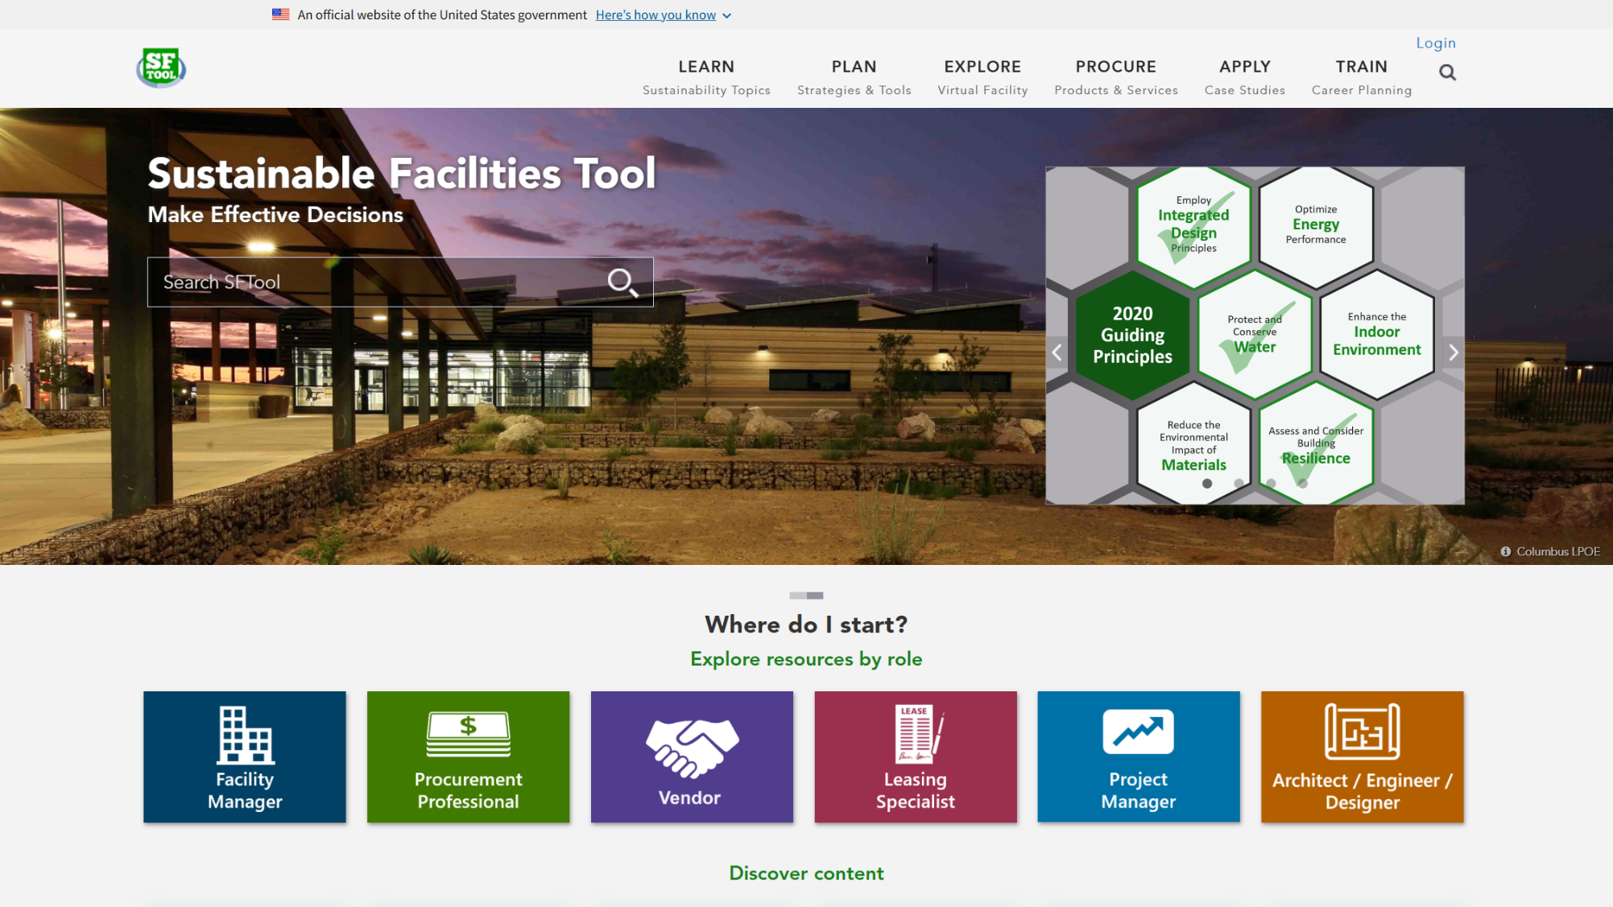
Notes:
This presentation will step through all of the SFTool sections listed on the top menu bar. This will expose you to the complex world of sustainable design, construction, and operations in a succinct and simplified context that allows you to grasp the whole system and learn technical concepts. You will also learn the power of bundling and building integrated teams.
SFTool:
Identifies cost-effective sustainable building and procurement strategies to improve environmental performance and occupant health.
Models an inclusive approach to sustainable practices that moves beyond large mechanical systems & expert-led construction projects.
Clarifies the relationship between sustainability guidance and the physical, financial and human resources we seek to conserve.
Engages and empowers people to ask questions, persuade others and make informed decisions -- regardless of previous knowledge level or role.

Slide 4
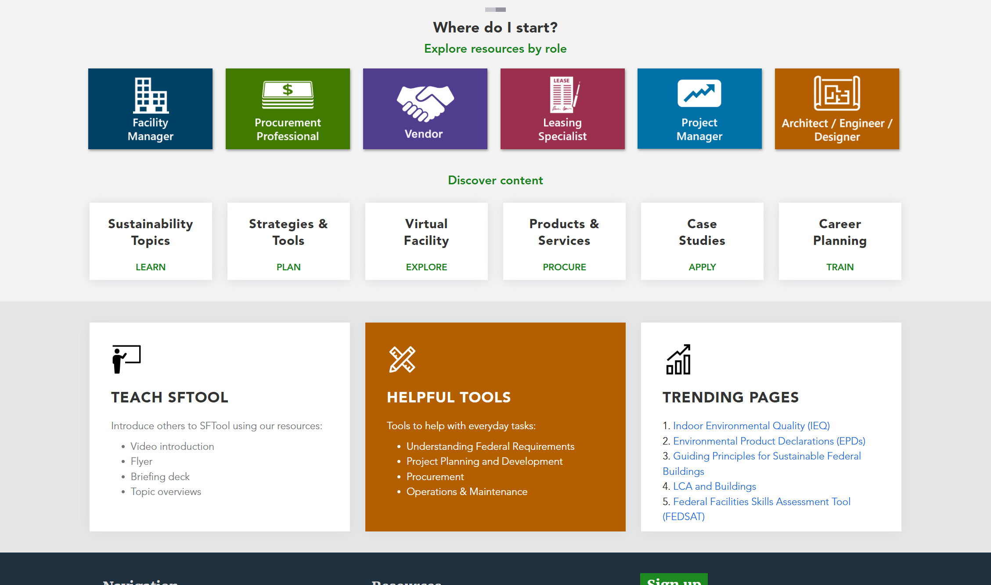
Notes:
To start, scrolling down the homepage will show links to more resources. If you click on the Teach SFTool box...

Slide 5
Notes:
You’ll find a page where you can watch several SFTool videos and download resources, including the template for this briefing!

Slide 6
Notes:
From the homepage, you can also access User Guides for various project team members.

Slide 7
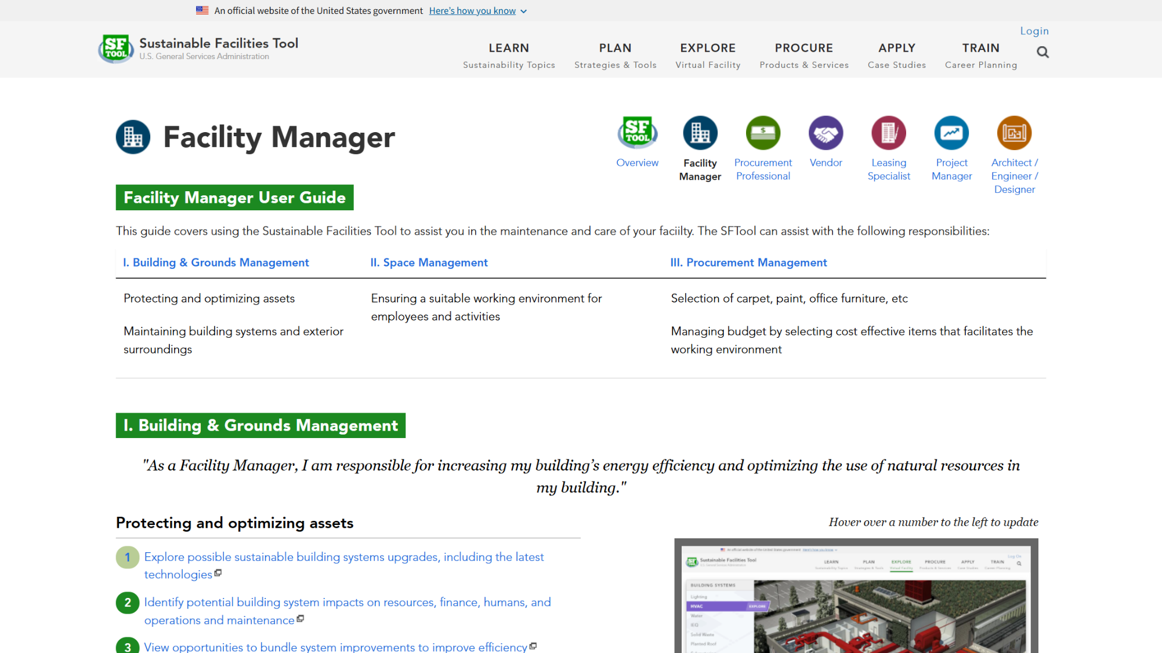
Notes:
Each User Guide walks users through the SFTool features and resources that can assist with their project responsibilities.

Slide 8
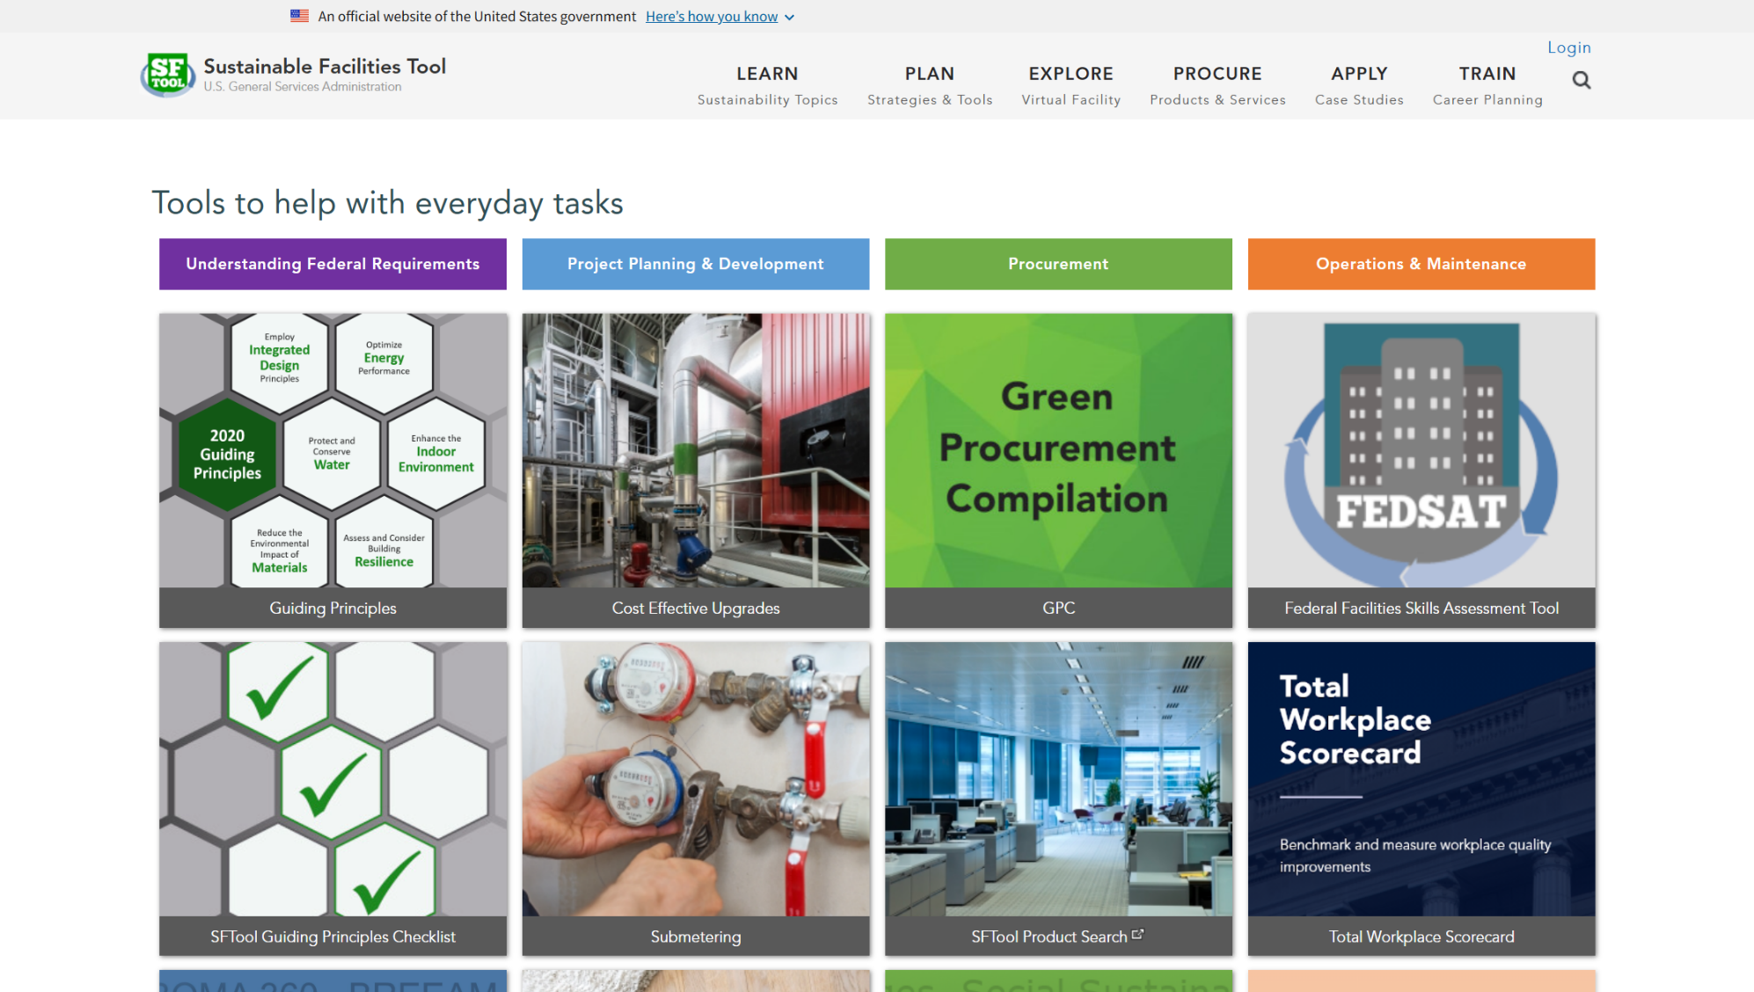
Notes:
If you want to quickly find the major tools, visit the Helpful Tools page. Otherwise, you can start by exploring each section using the top tabs…

Slide 9
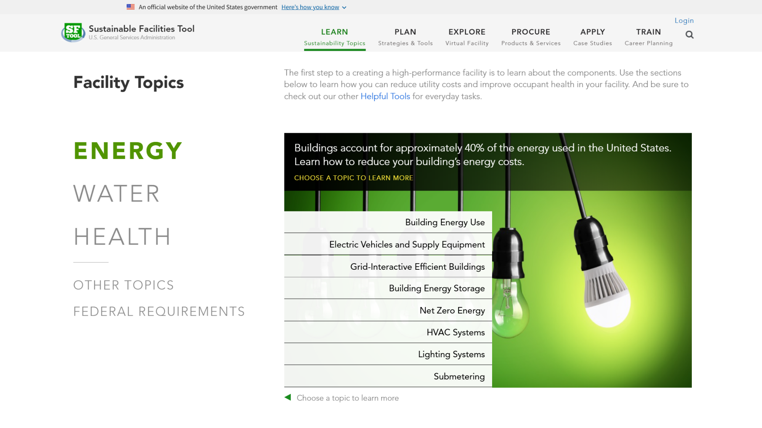
Notes:
In the Learn section, you can read descriptions, tips, and case studies about everything from water efficiency to plug load reduction. You can also view legislation and understand the impact of policy on sustainability.

Slide 10
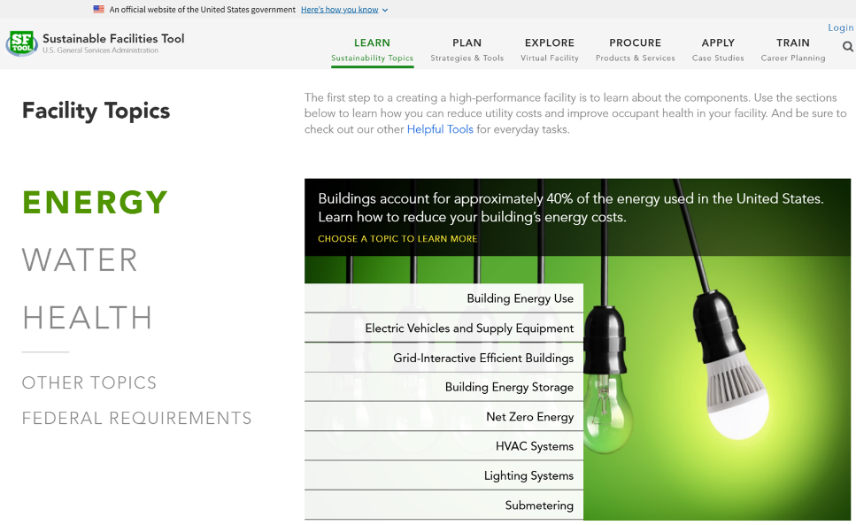
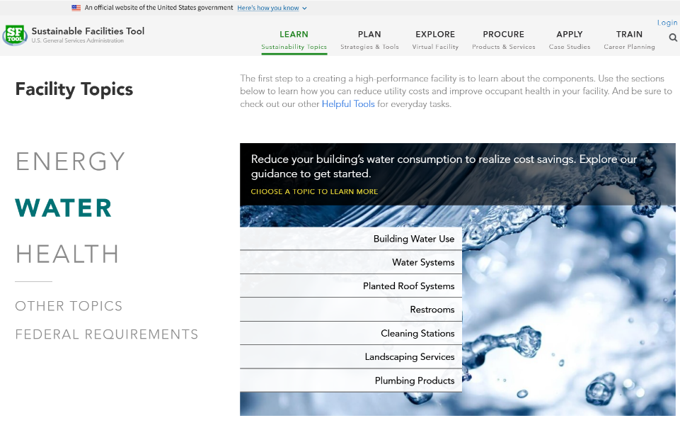
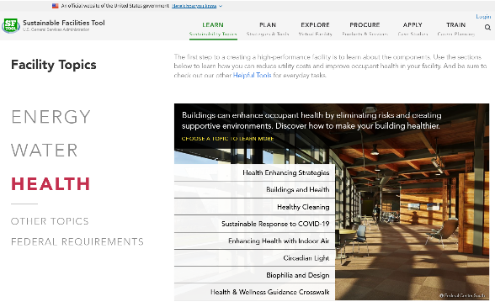
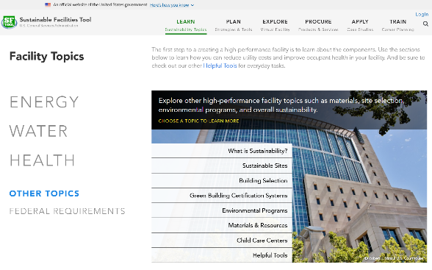
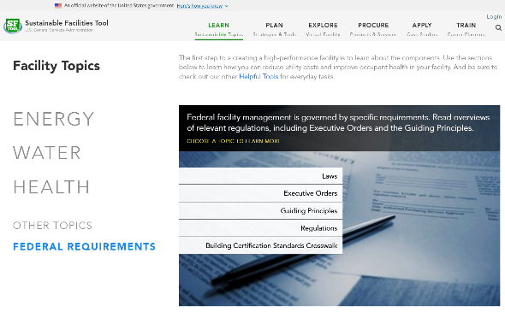
LEARN
02/2025
Notes:
Learn topics are divided into Energy, Water, Health, and Federal Requirements. There’s also an Other Topics area that addresses broader concepts such as sustainable sites and building selection.

Slide 11
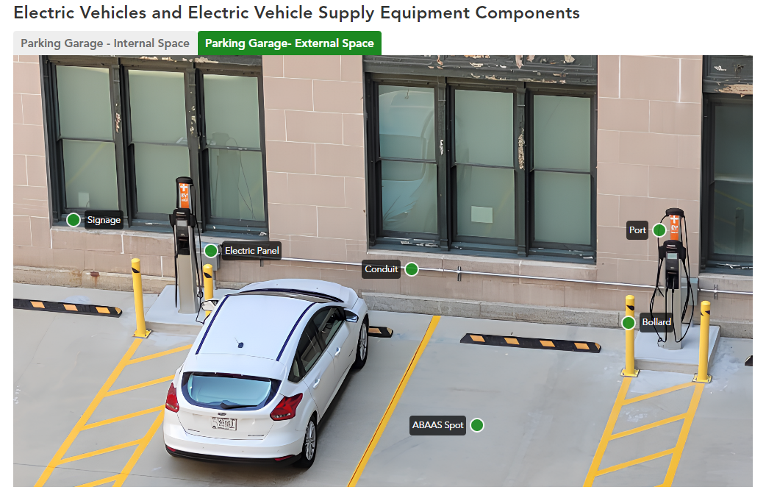
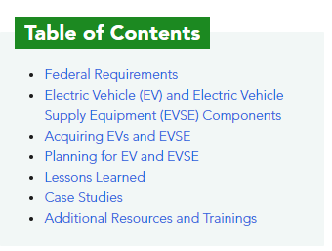
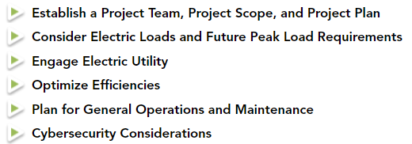
LEARN – Electric Vehicle Supply Equipment
02/2025
Notes:
From the Energy area, one of the newest pages is on Electric Vehicle Supply Equipment. This page explains terminology, describes technology options, and provides guidance for how to establish an EV program.

Slide 12
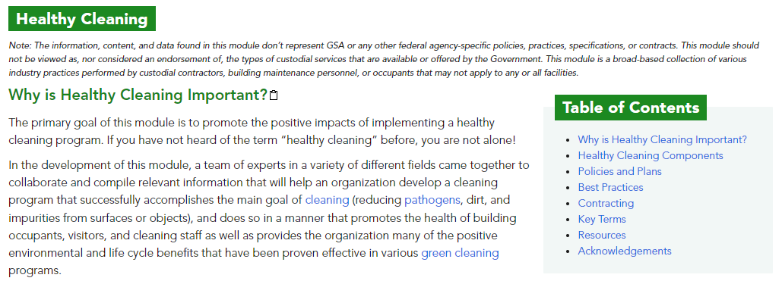
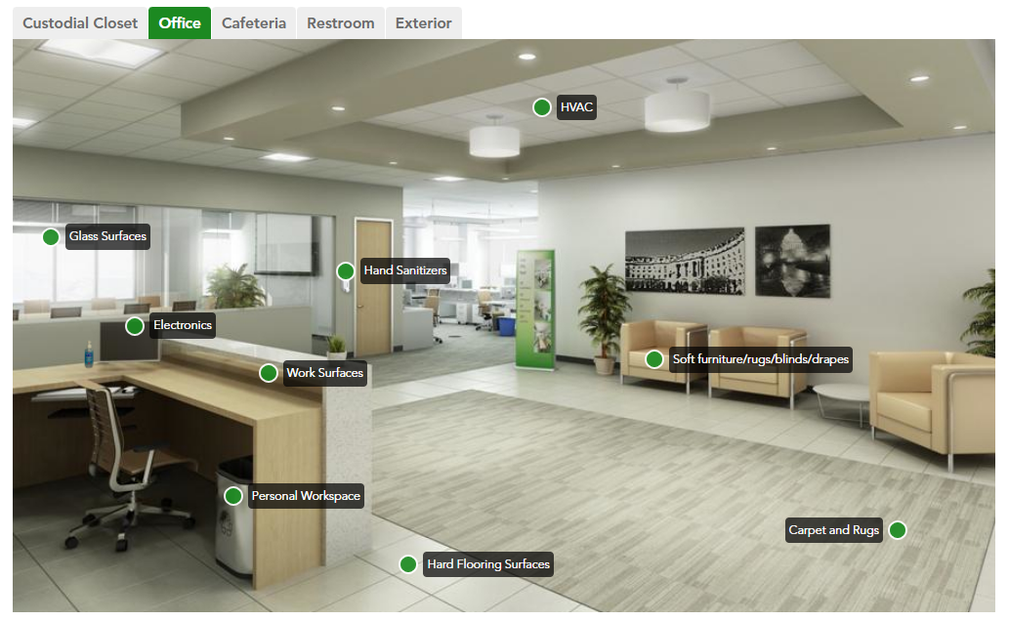
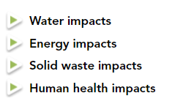
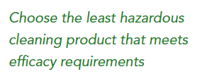
LEARN – Healthy Cleaning
02/2025
Notes:
From the Health area, you can explore extensive resources on Healthy Cleaning – from understanding the basics to designing a program.

Slide 13
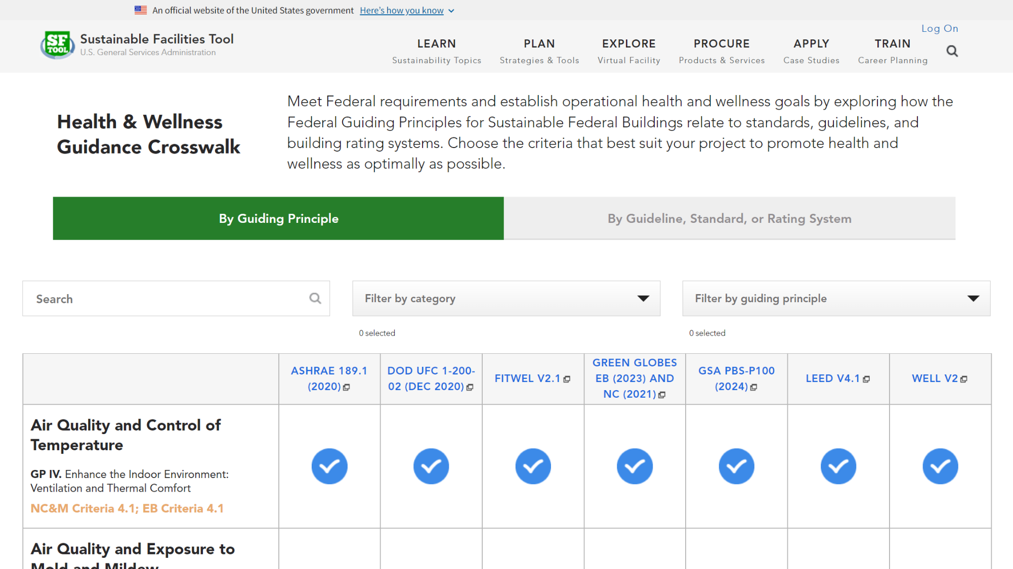
Notes:
The Learn section also includes two crosswalks, which allow you to explore how various guidelines, standards, and rating systems address the Guiding Principles for Sustainable Federal Buildings. This crosswalk focuses on the health aspects of the Guiding Principles.

Slide 14
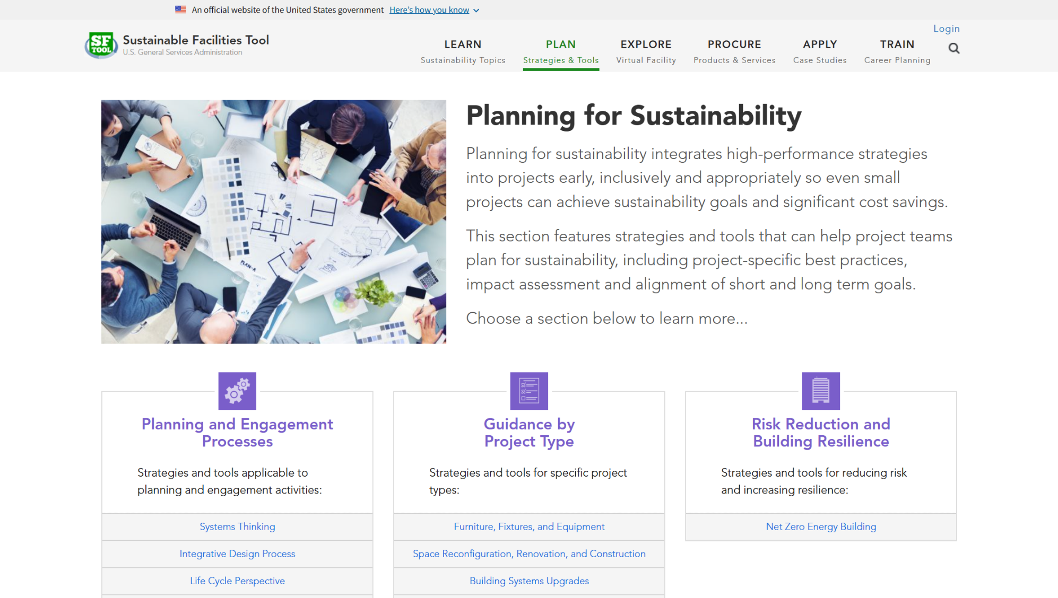
Notes:
Visit the Plan section to get strategies for building sustainably or turning an existing space into a healthier environment. Try approaches that look at material lifecycles, help your building use clean energy or establish a solid waste reduction plan. Make sure you’re preparing for the long-term by reducing your risk and improving resilience.

Slide 15
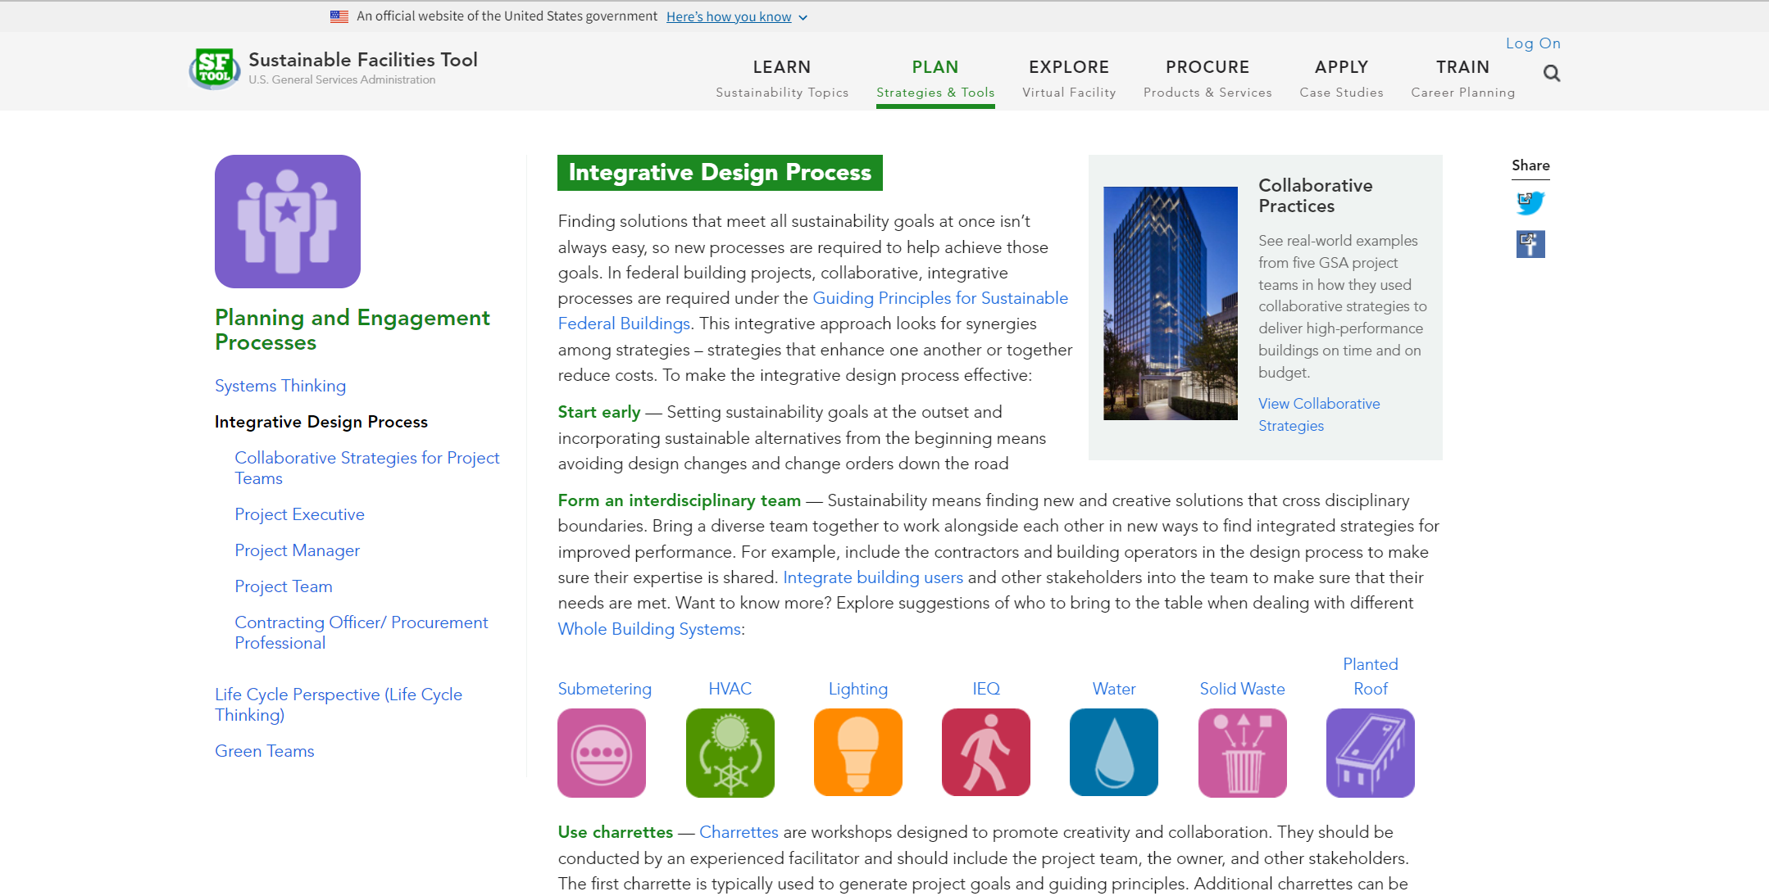
Notes:
A major theme in SFTool is integrative design. In the Plan section, you can learn how to build an interdisciplinary team and apply the integrative design process to your projects.

Slide 16
Notes:
This section includes collaborative strategies from GSA projects that you can apply to your own role.

Slide 17
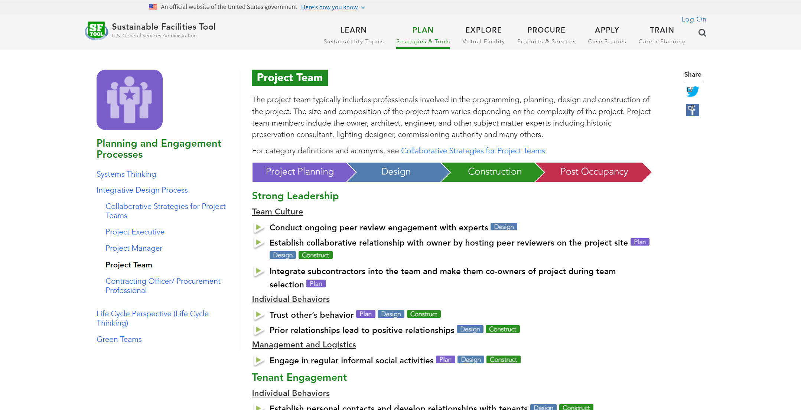
Notes:
Within each role, you can explore strategies by topic or use the color tags to view all strategies for a particular project phase.

Slide 18
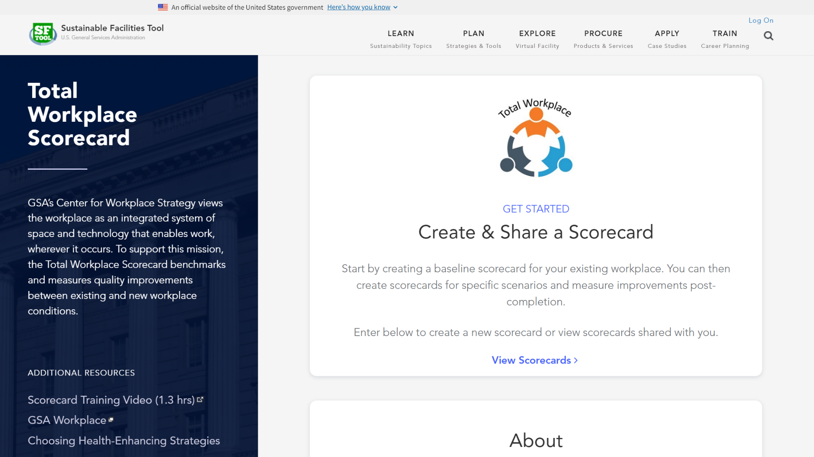
Notes:
The Total Workplace Scorecard allows you to benchmark and measure improvements to workplace conditions. To get started, click “View Scorecards” and log in.

Slide 19
Notes:
From the main menu, you can create and manage your scorecards. Start by going to “Create new scorecard”.

Slide 20
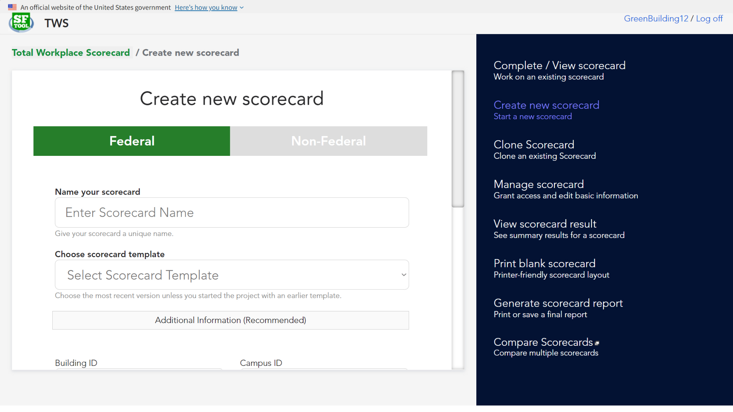
Notes:
Choose whether it’s a federal or non-federal building, create a name, and select a template for either a whole or partial scorecard. You can also provide optional building information.

Slide 21
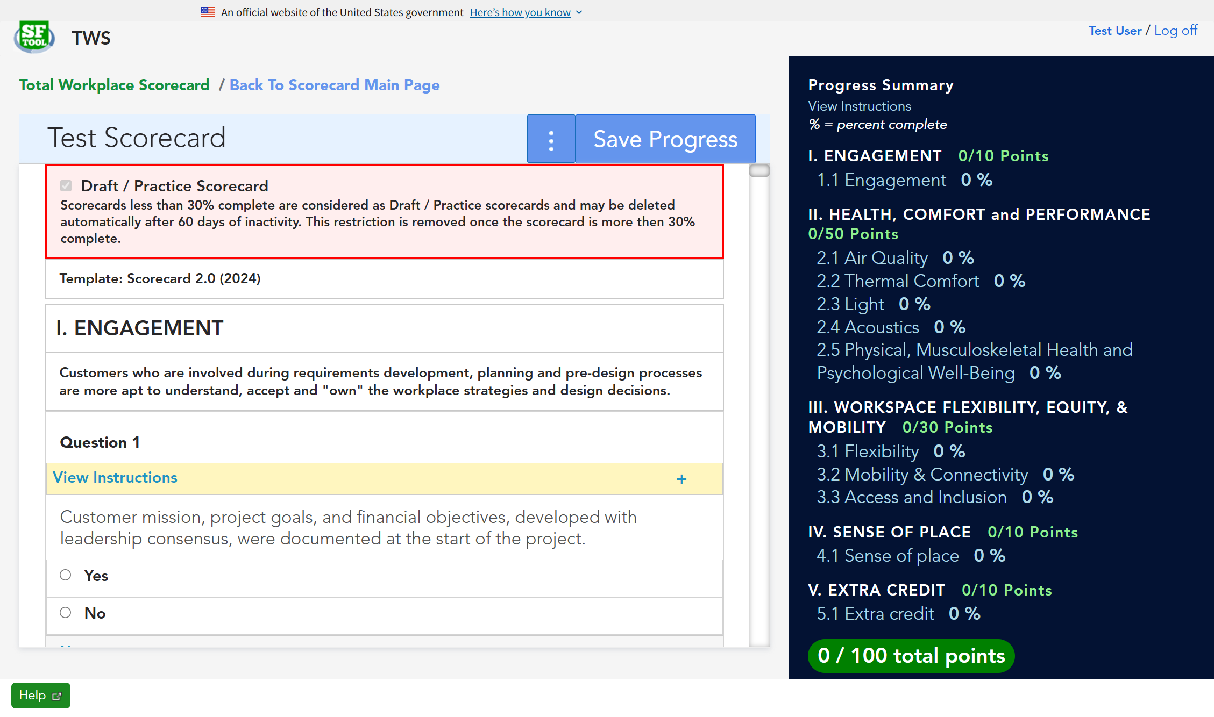
Notes:
You’ll then be able to start completing the scorecard. Select answers, add notes, and upload photo evidence when needed. Some questions will also provide additional instructions in a dropdown. Save your progress frequently to update the score.

Slide 22
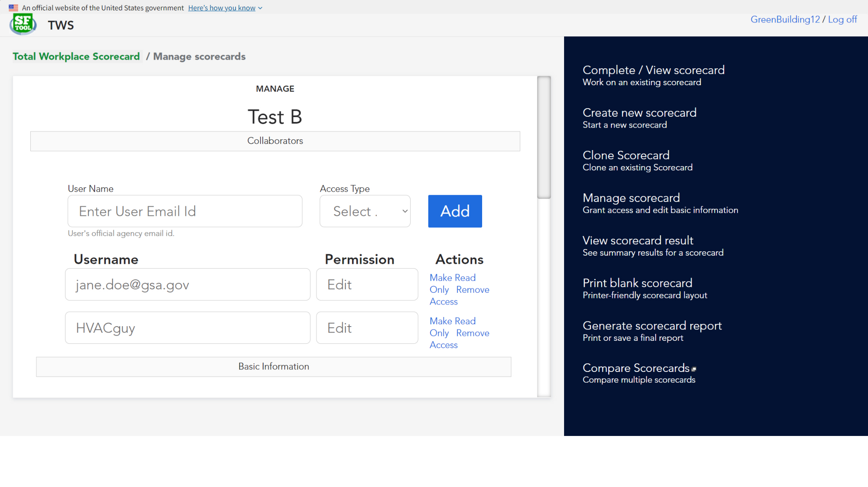
Notes:
Since the scorecard covers a wide variety of topics, you may want help. From the top of a scorecard or the main menu, you can manage access to your scorecards. This feature allows you to invite others to view or edit the scorecard, as well as edit the basic building information.

Slide 23
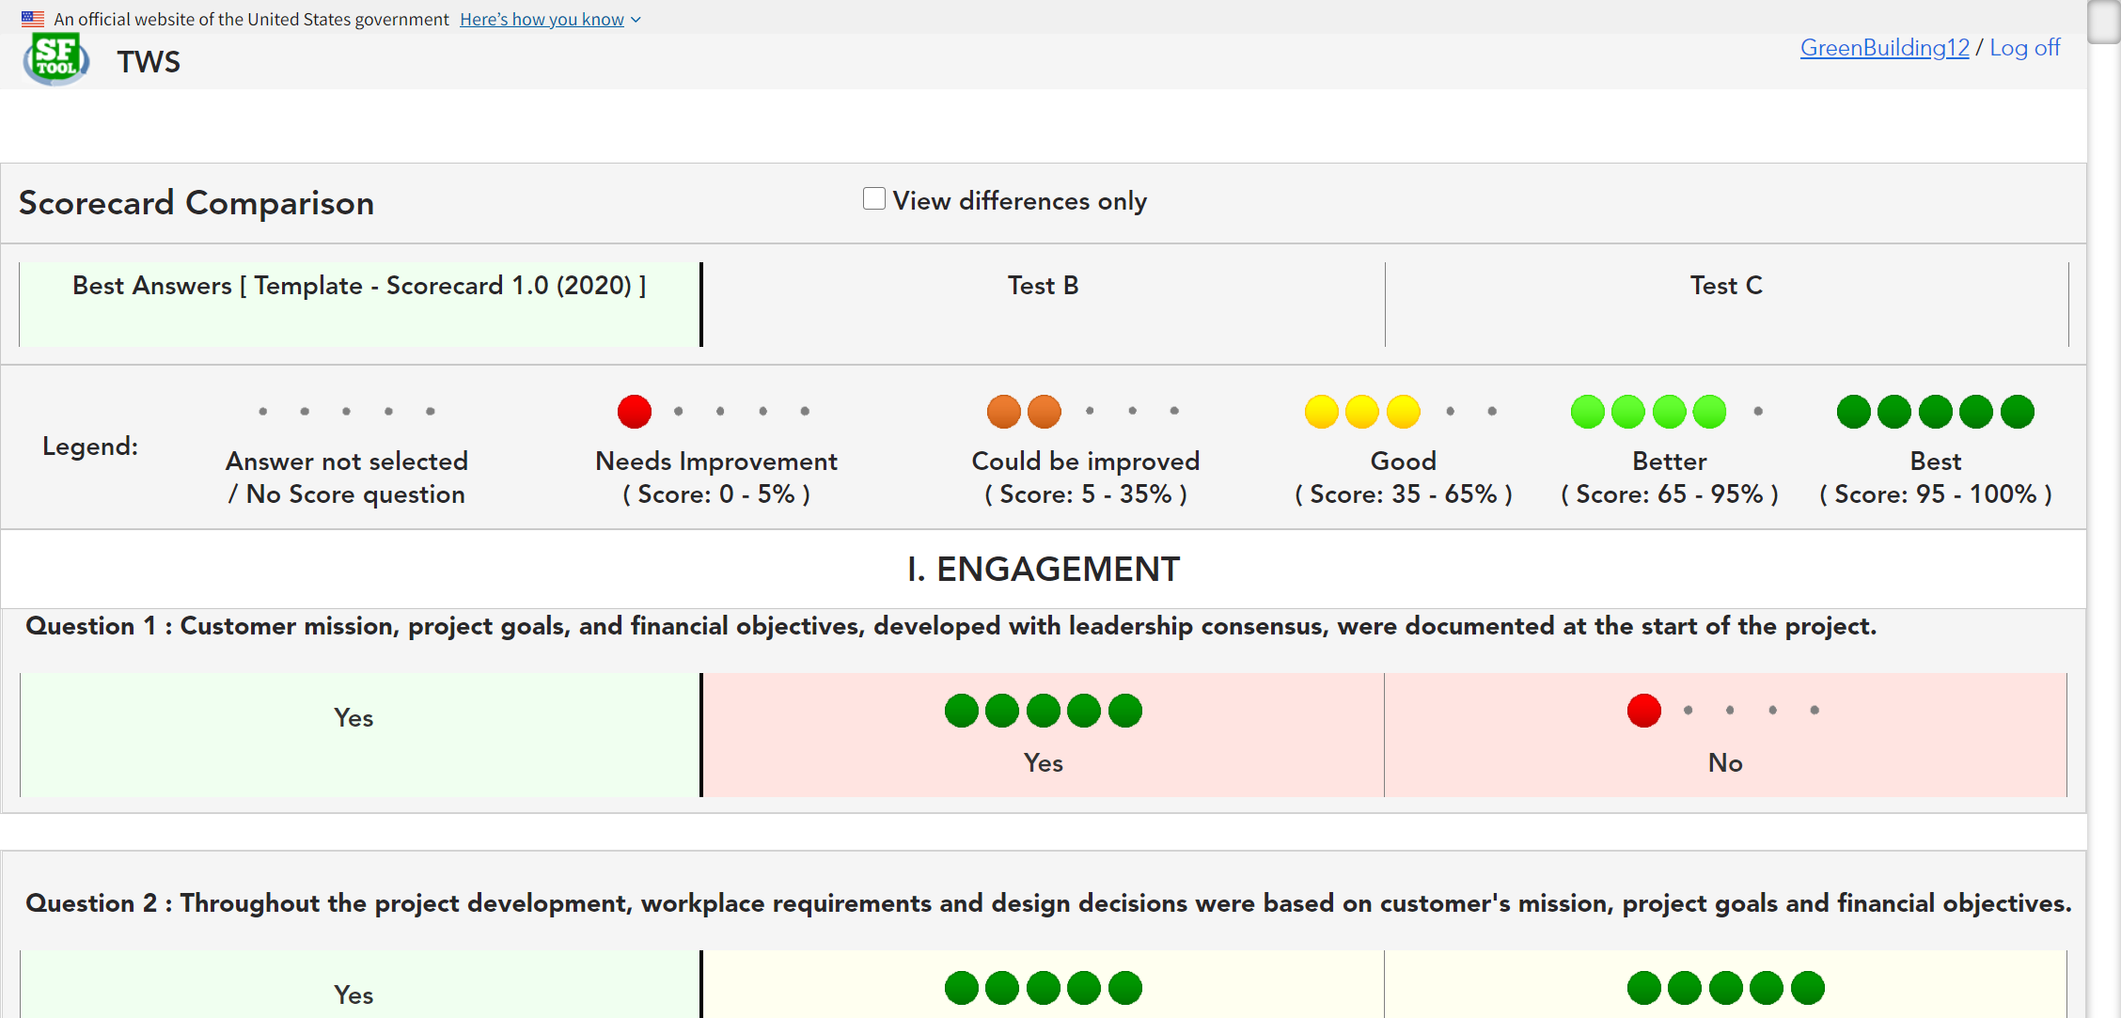
Notes:
You can also compare scorecards to see how much you’ve improved or to run scenarios. The first column will always show the best answer for reference. Different answers are color coded for quick references, with a filter at the top to just show differences only.

Slide 24
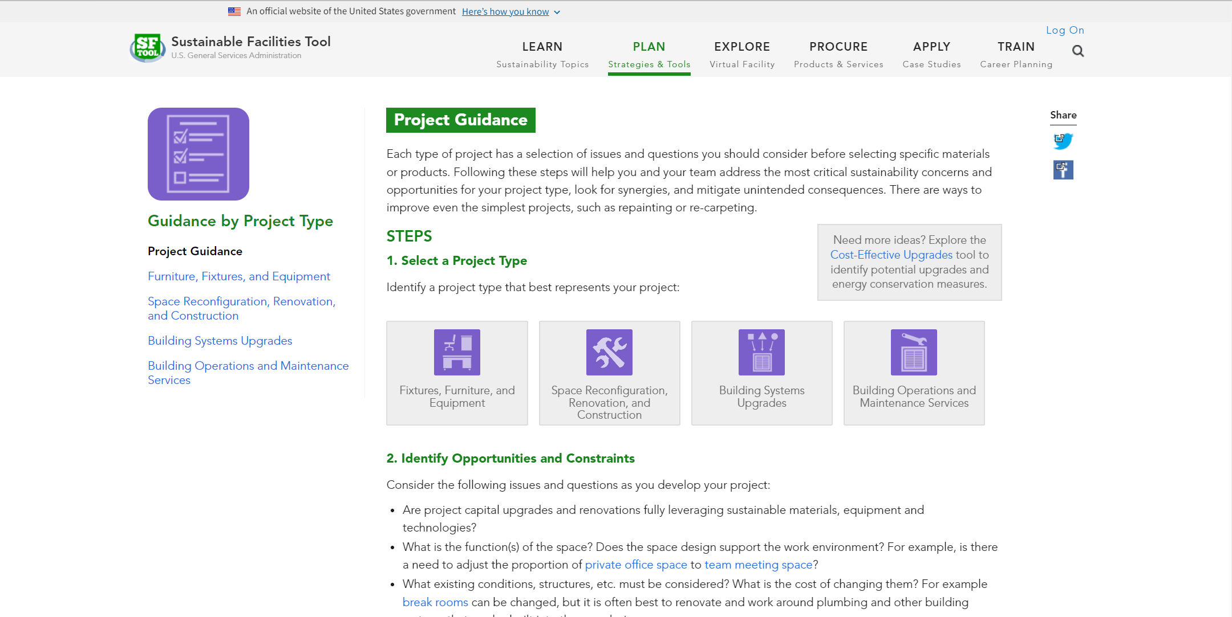
Notes:
The Plan section also includes guidance for specific project types.

Slide 25
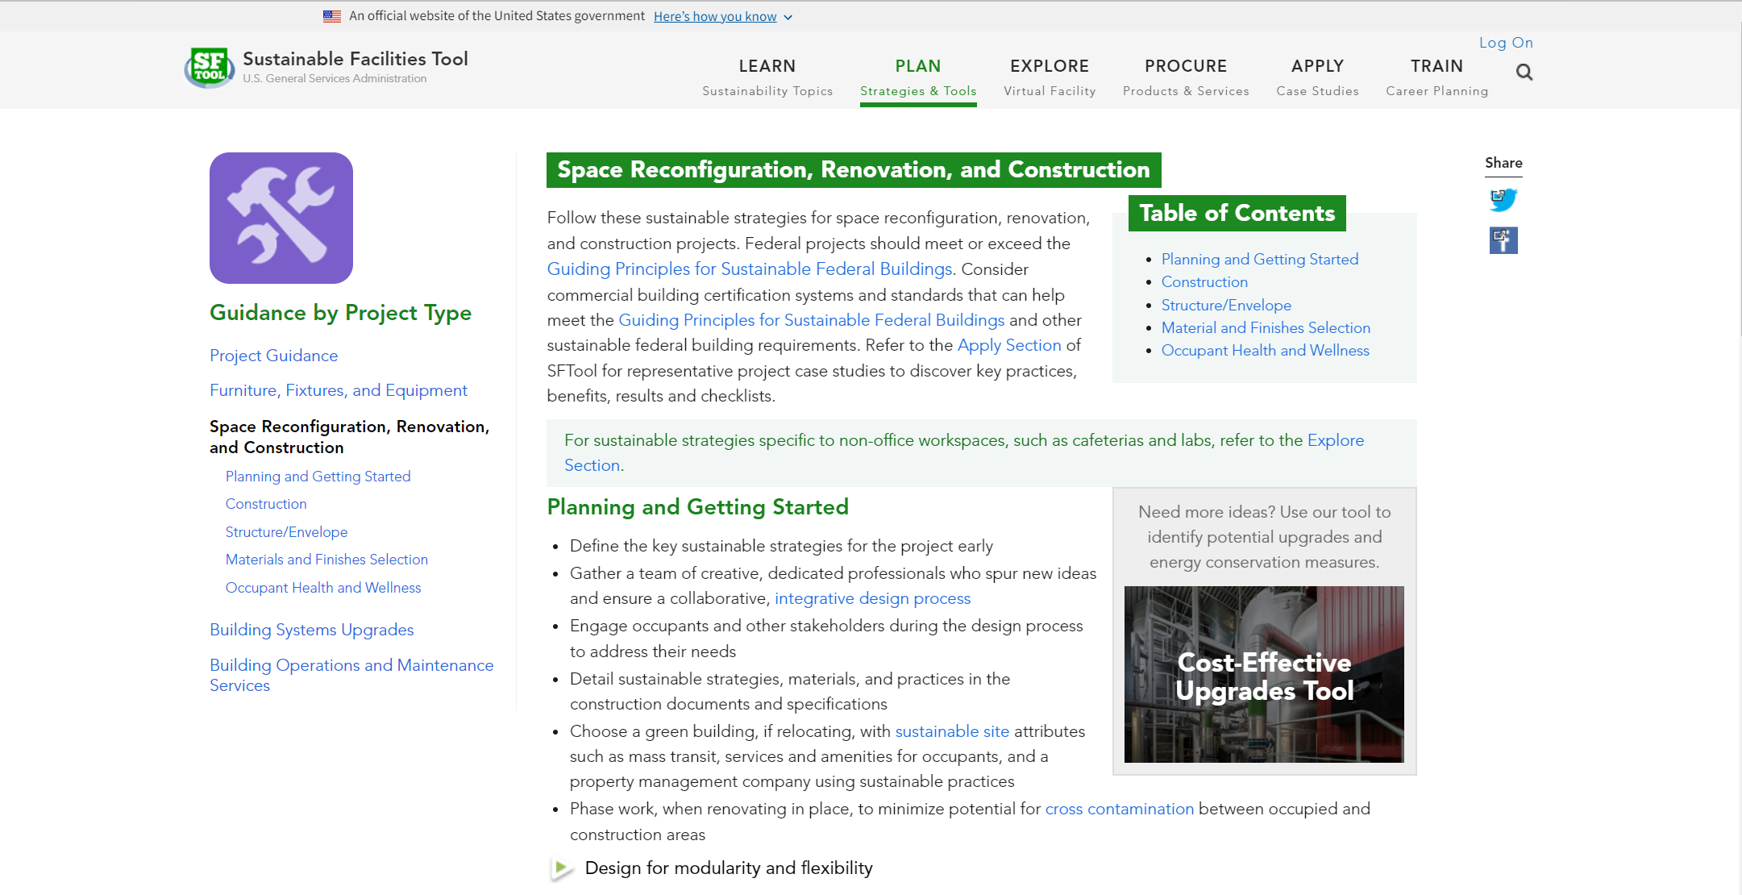
Notes:
For example, the Space Reconfiguration, Renovation, and Construction project type allows PMs to see a “brain dump” of considerations and requirements associated with specific aspects of a project (for example, Materials and Finishes Selection).

Slide 26
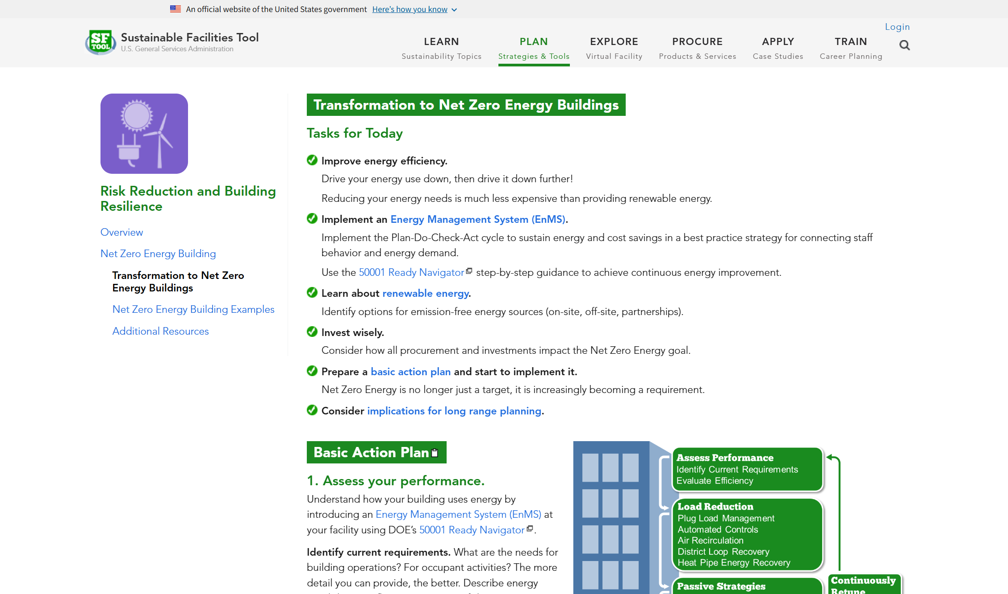
Notes:
The Plan section can also help you with long-term projects by translating complex topics into action plans.

Slide 27
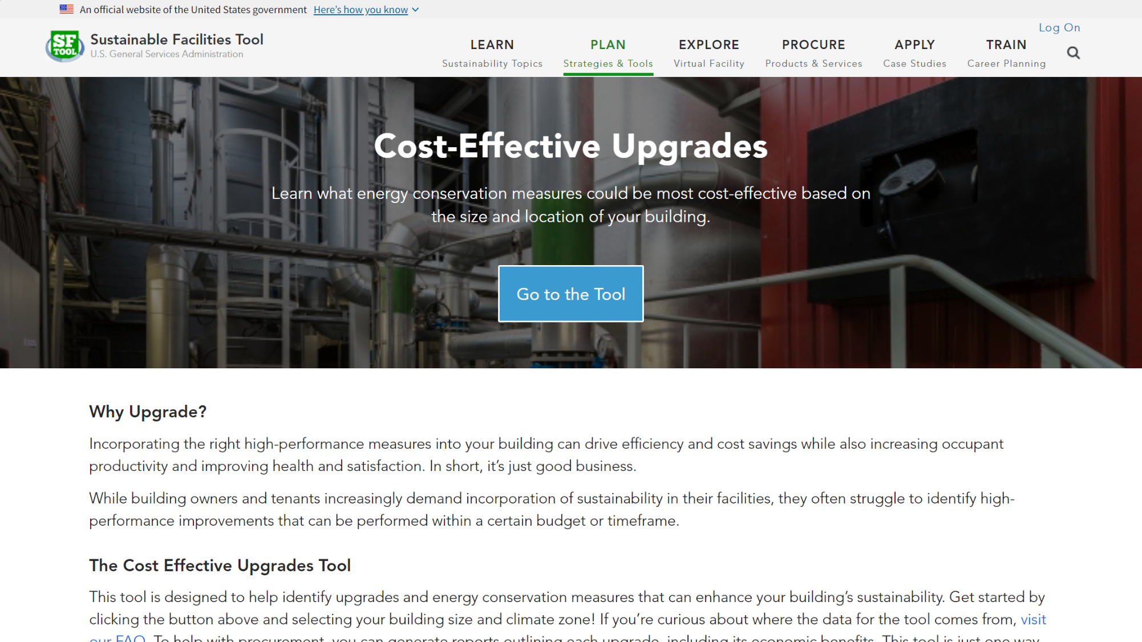
Notes:
You can also use the Cost-Effective Upgrades Tool to identify potential high-performance improvements.

Slide 28
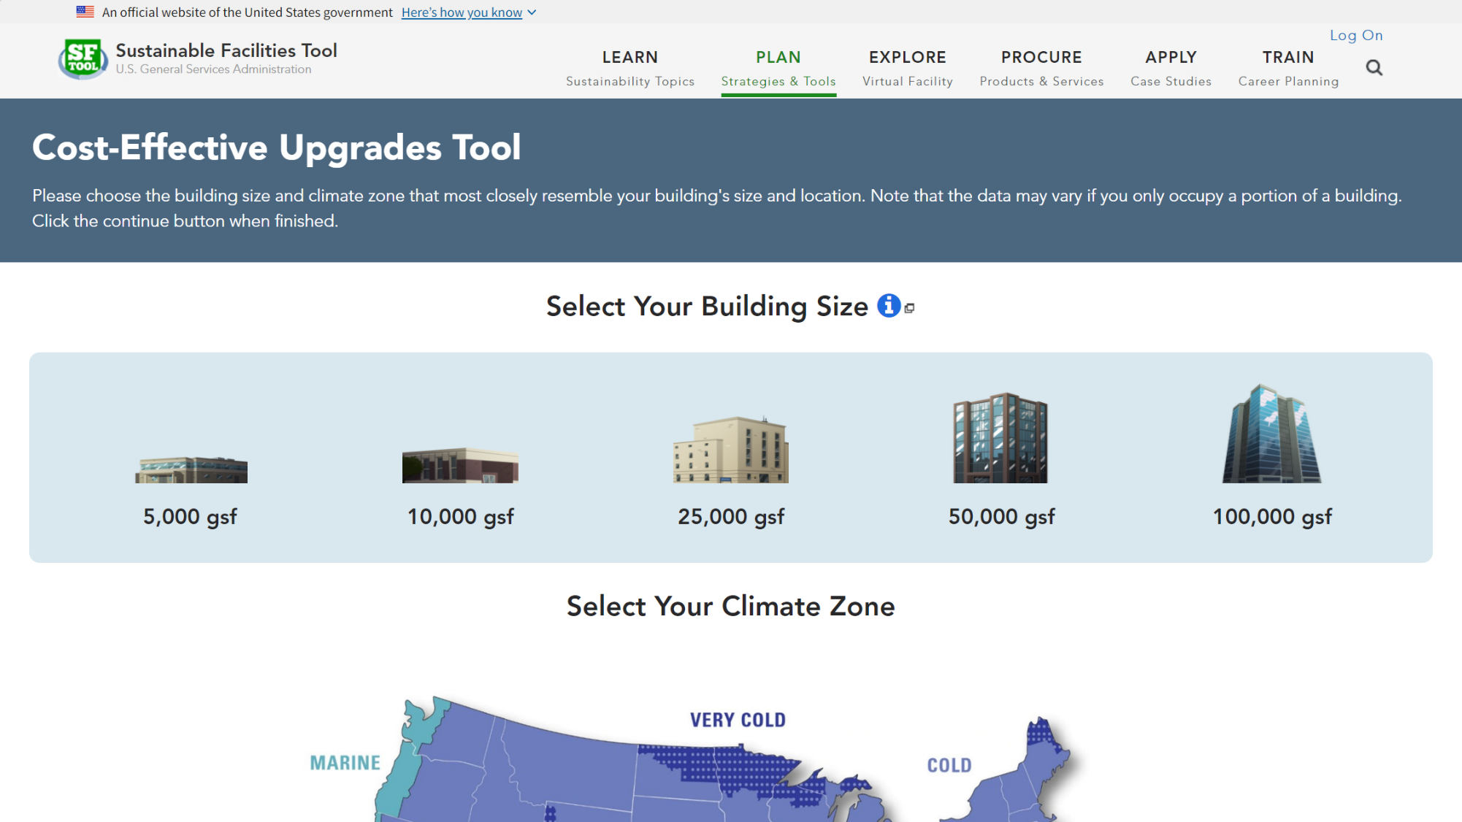
Notes:
Frist, select your building’s size and climate zone.

Slide 29
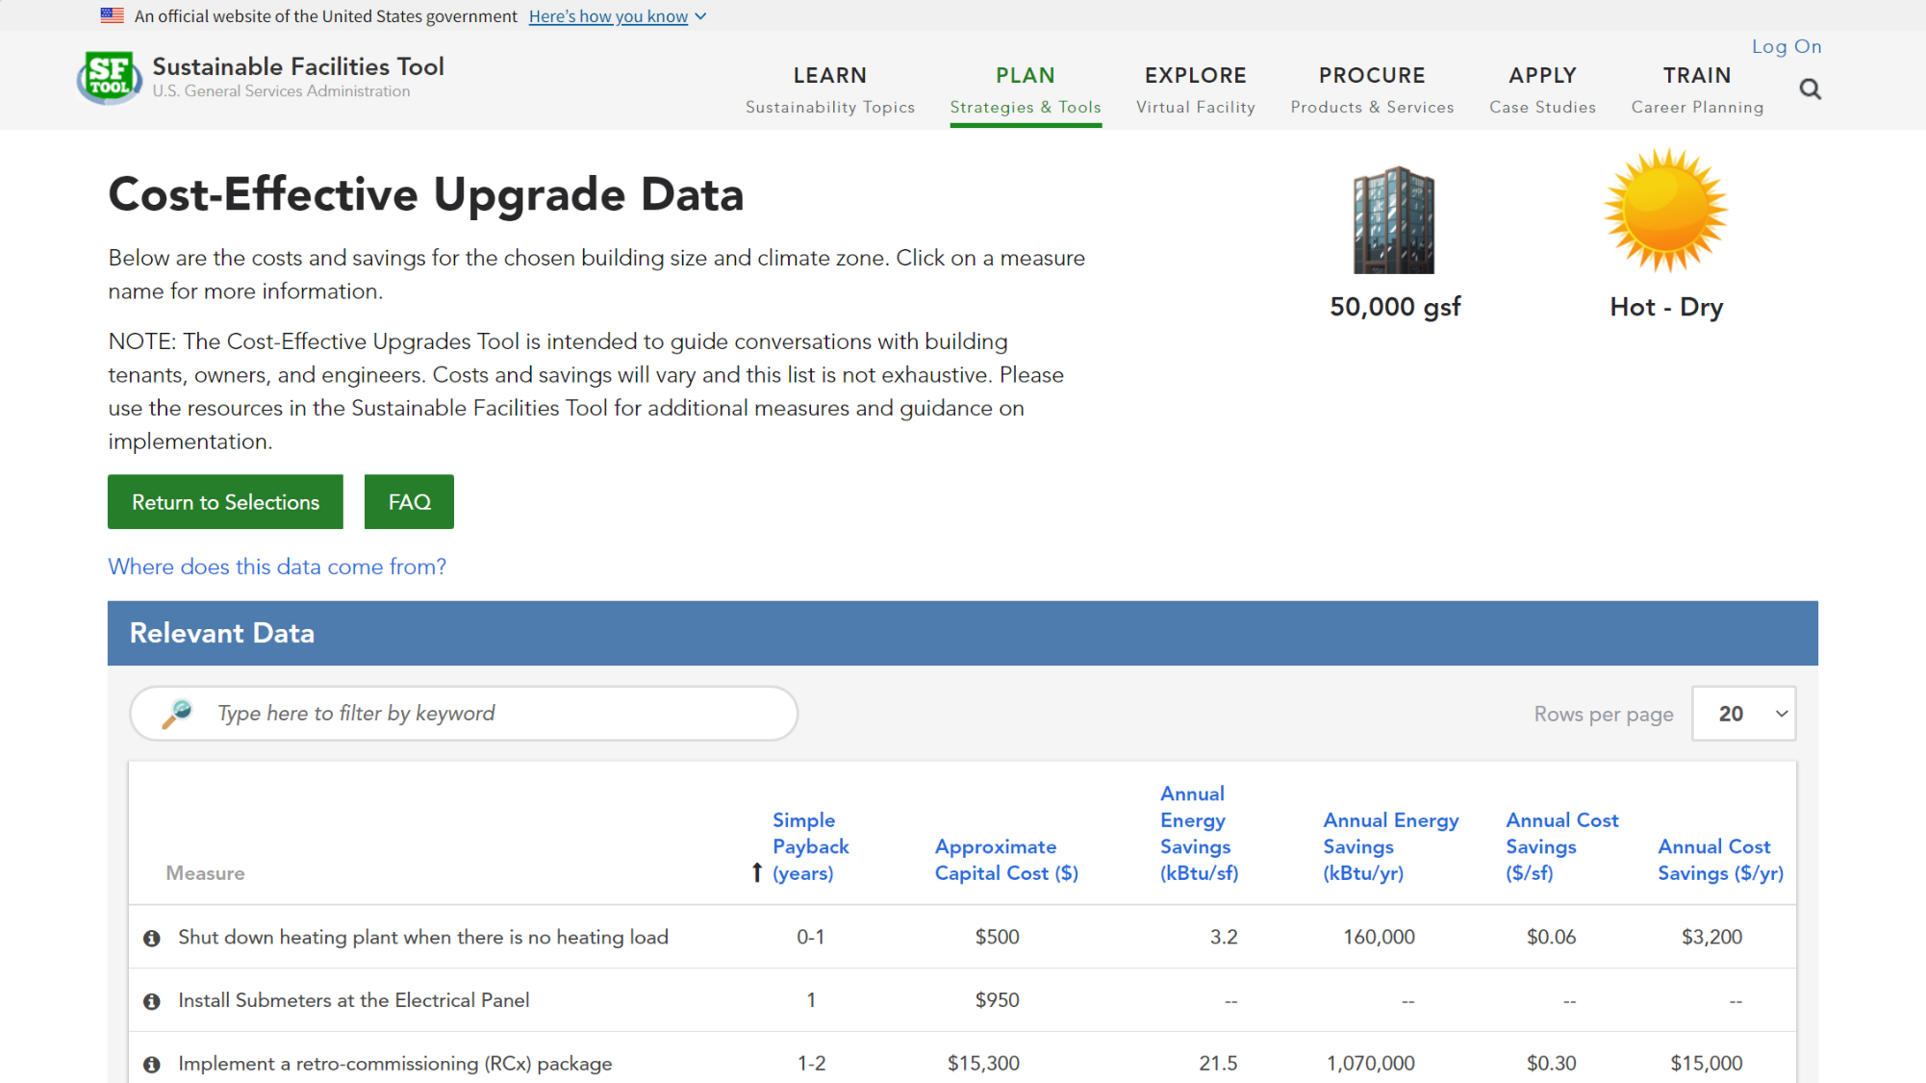
Notes:
Then explore measures that may be cost-effective for your building.

Slide 30
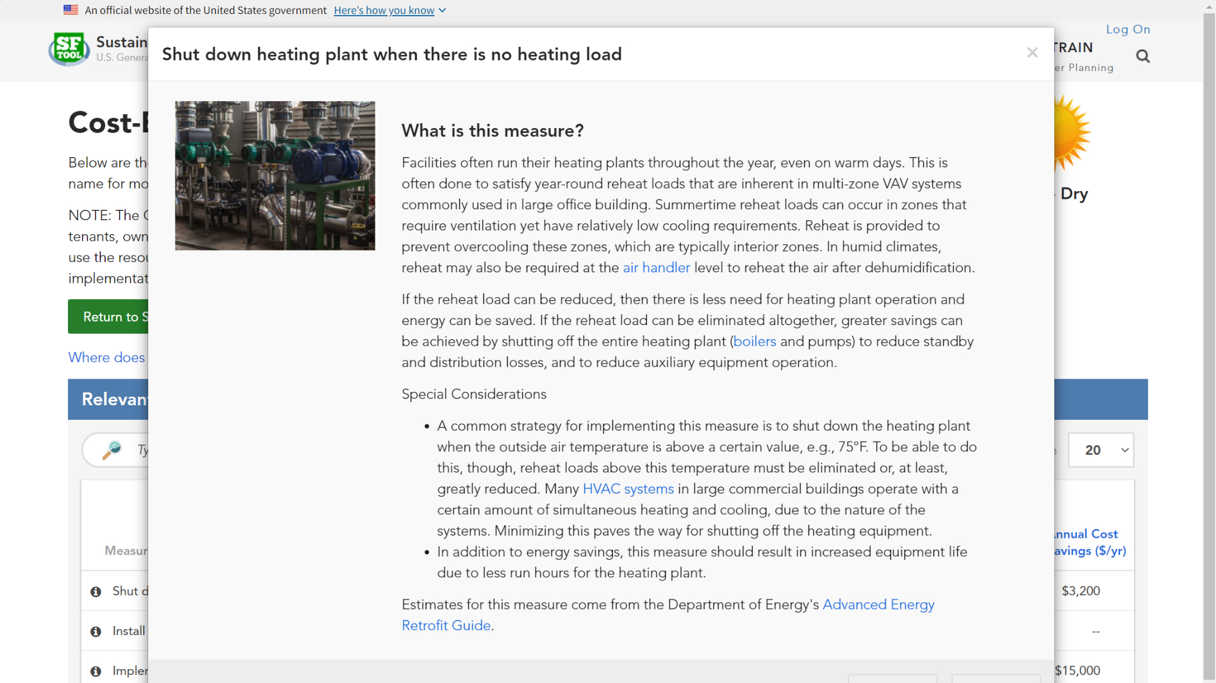
Notes:
Each measure includes a description and tips, as well as links to more information.

Slide 31
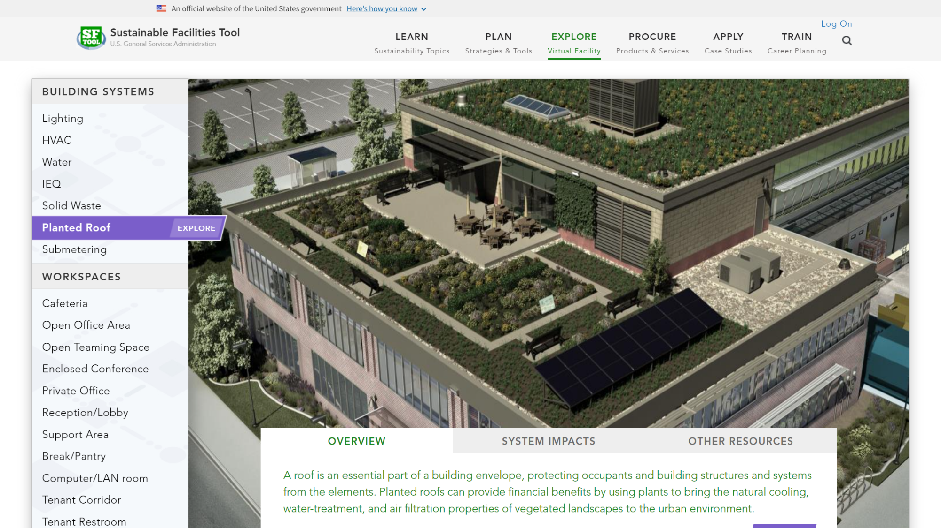
Notes:
In the Explore section, roam around a virtual building to compare materials and design strategies.

Slide 32
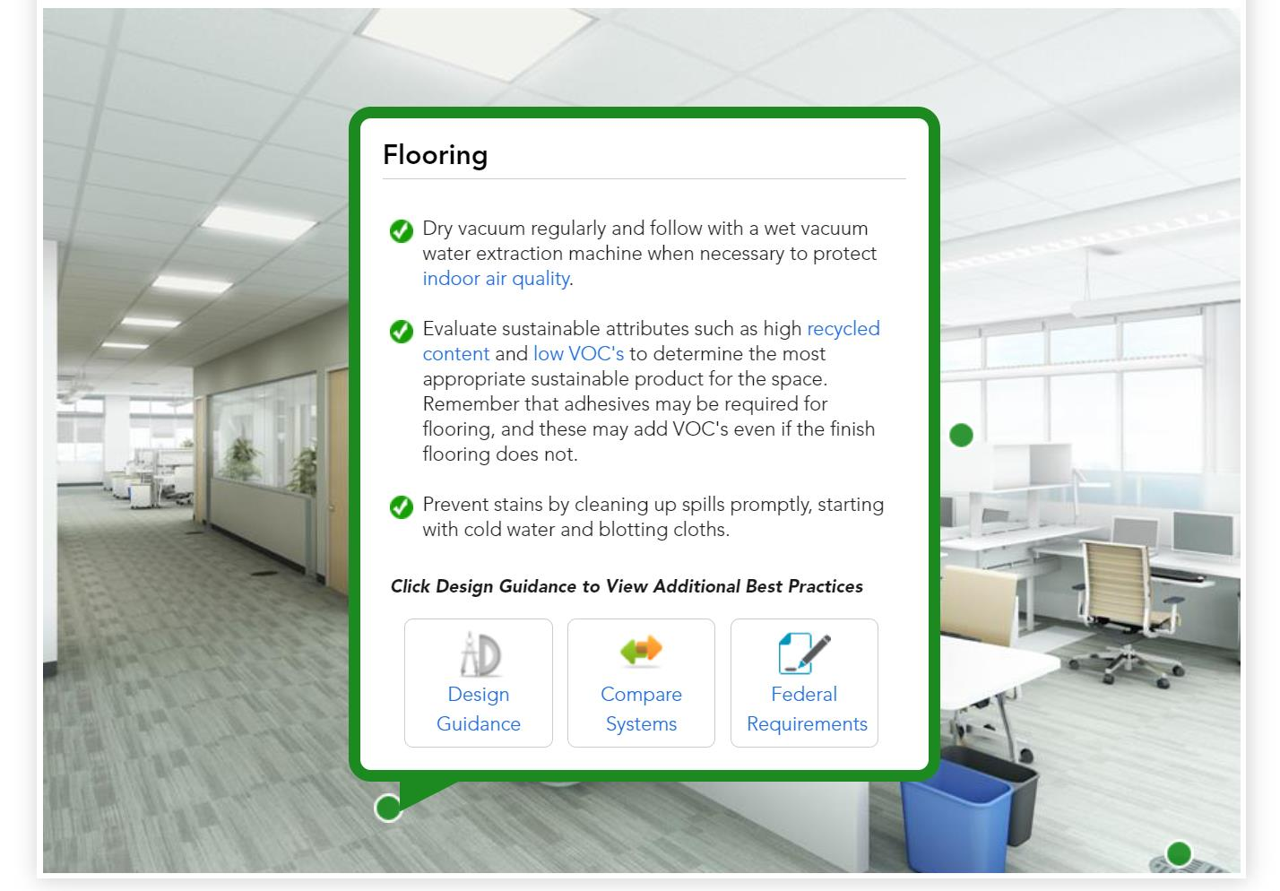
Notes:
Click on the green dots to learn more about each material.

Slide 33
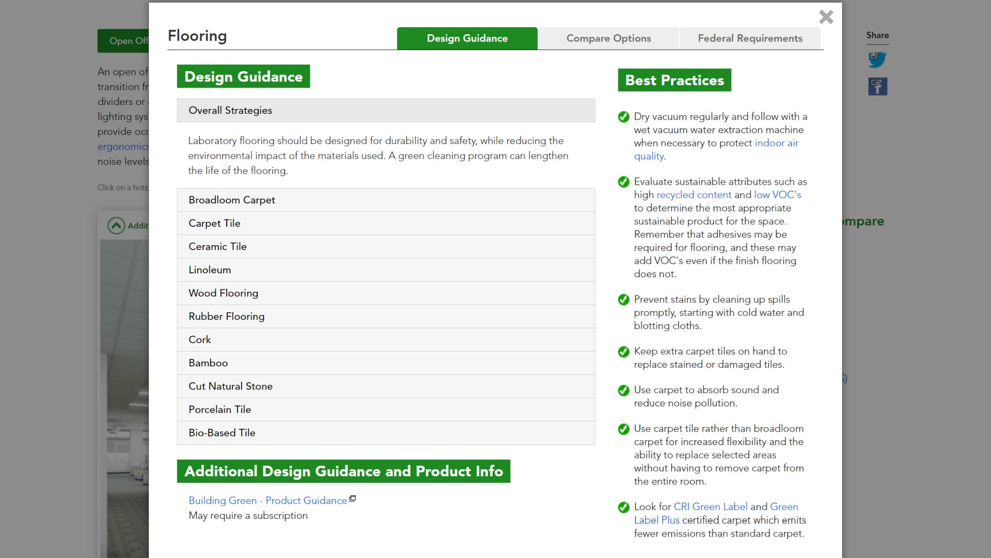
Notes:
Each material includes design guidance….

Slide 34
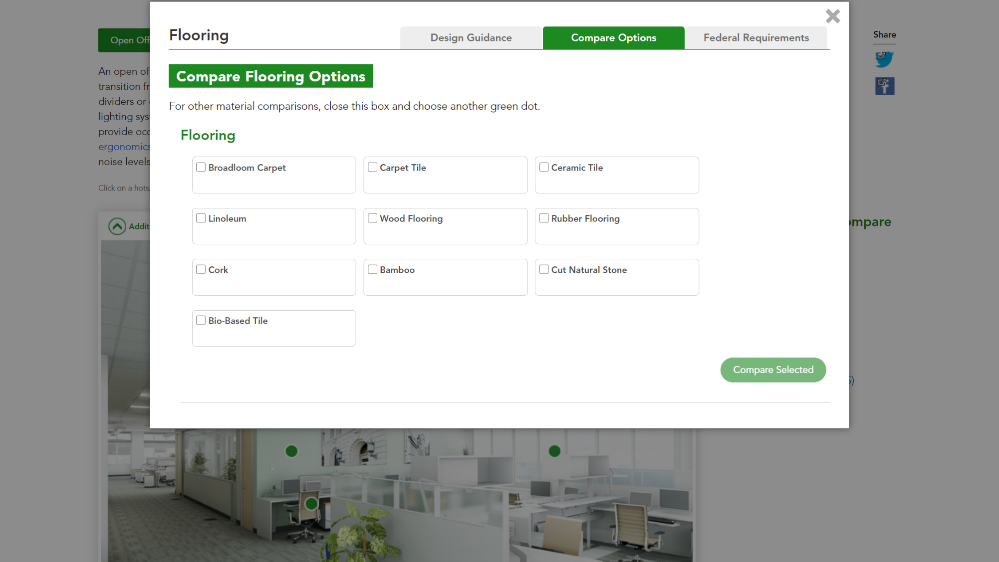
Notes:
…the ability to compare options across a wide variety of factors, such as life cycle cost and impact on indoor air quality…

Slide 35
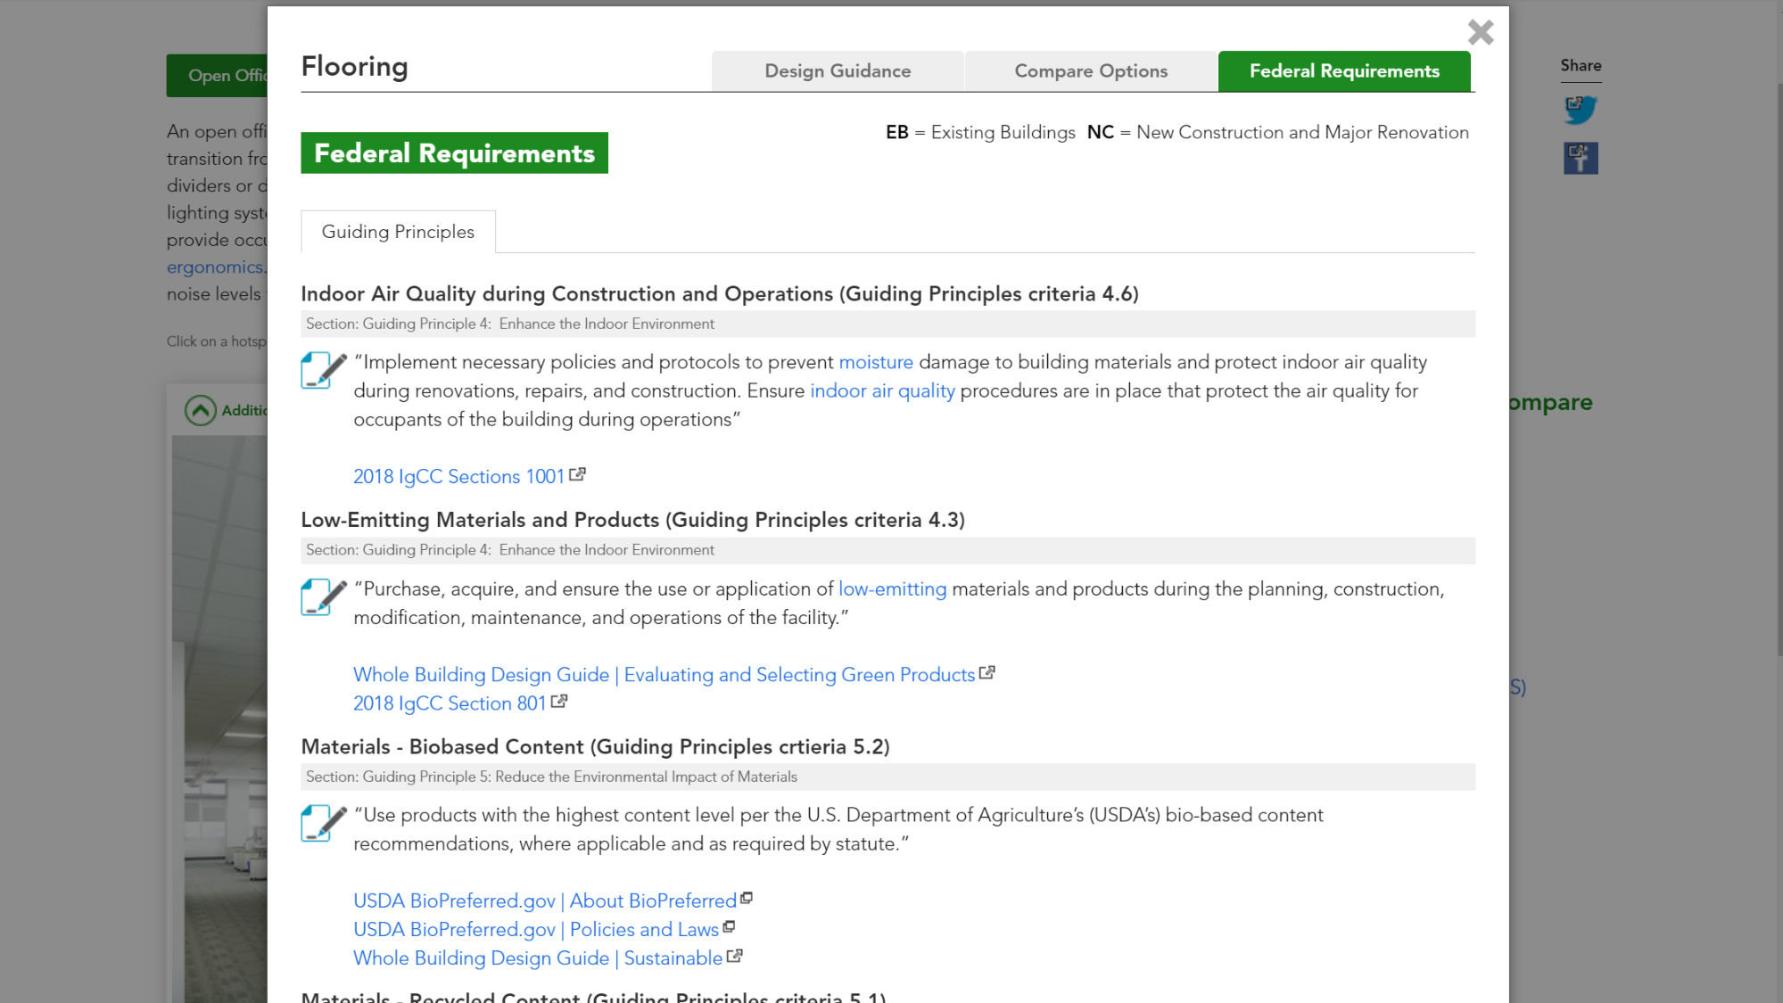
Notes:
…and related federal requirements.

Slide 36
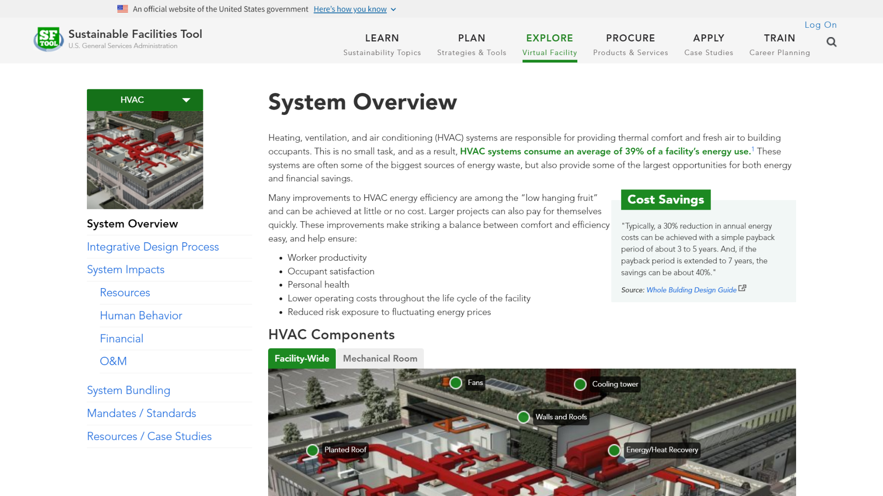
Notes:
You can also explore building systems, such as HVAC, lighting, and water, which highlight interactions between building systems and the people they serve.

Slide 37
Notes:
For each system, you can see how your role helps a team reduce costs and increase environmental sustainability.

Slide 38
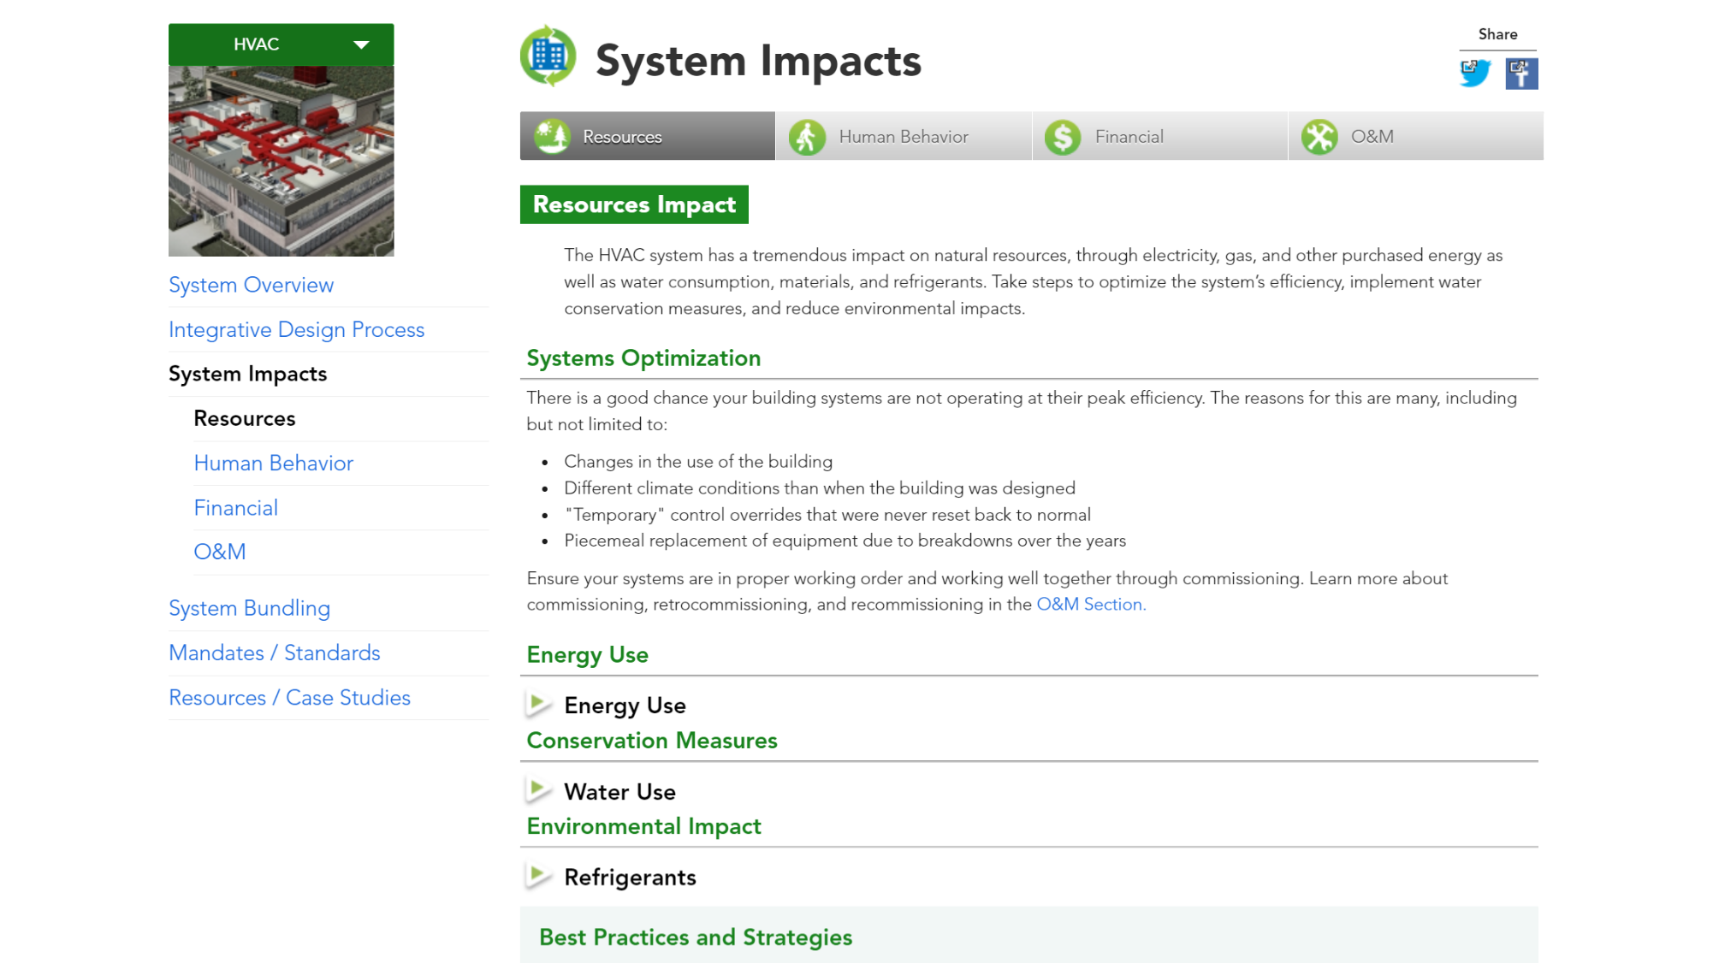
Notes:
You can also explore a system’s various impacts. We start with resources. HVAC systems have a significant impact on the building's overall energy and water use. Take into consideration these impacts to optimize your building performance.

Slide 39
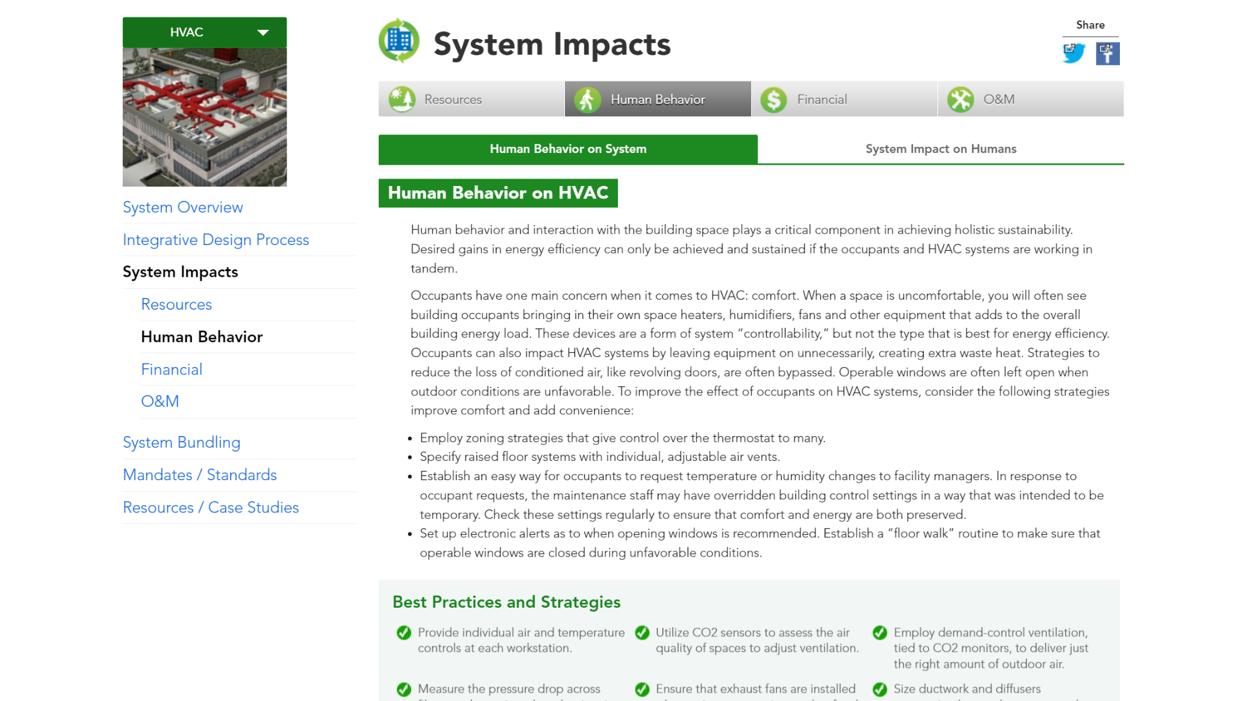
Notes:
HVAC systems also have an impact on the people in the building. And just as importantly, human behavior has an impact on system operation.

Slide 40
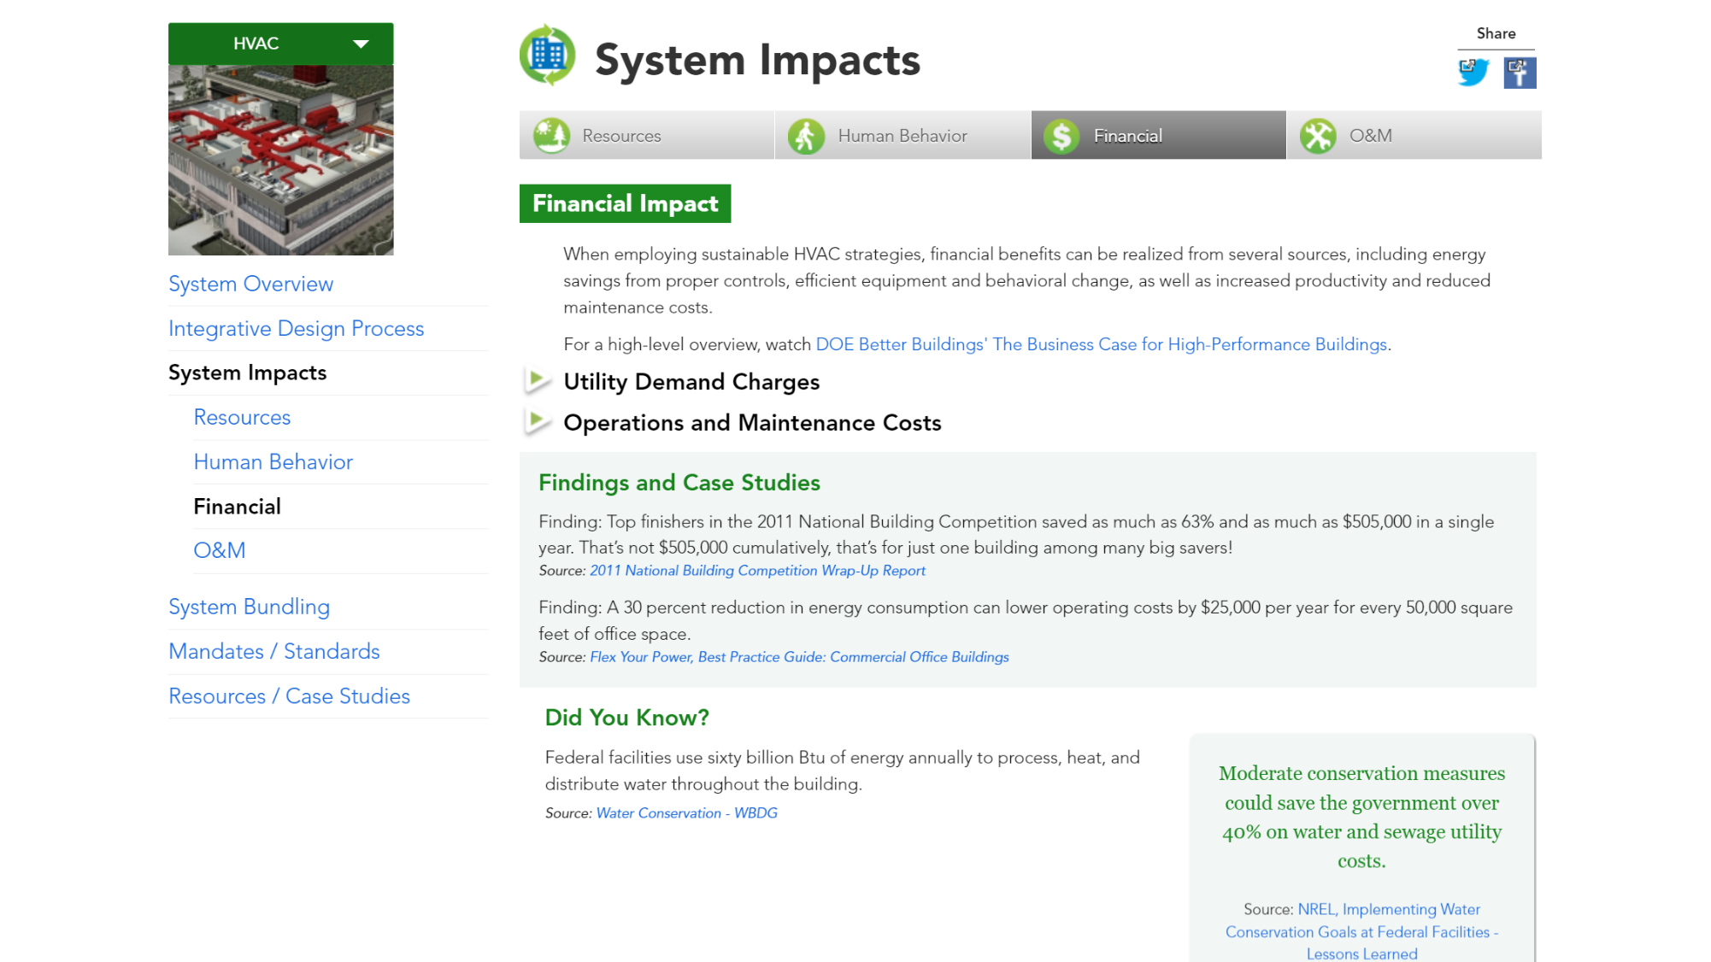
Notes:
Each system also has financial impacts. This section includes how high-performance improvements could help lower costs.

Slide 41
Notes:
You can also explore the system’s impact on operations and maintenance activities.

Slide 42
Notes:
When considering an HVAC renovation project, consider bundling components together to create strategies that deliver the largest beneficial impacts and greatest return on investment. The system bundling section can be leveraged to further understand whole building synergies and explore examples for ideas on what technologies might best be bundled together.

Slide 43
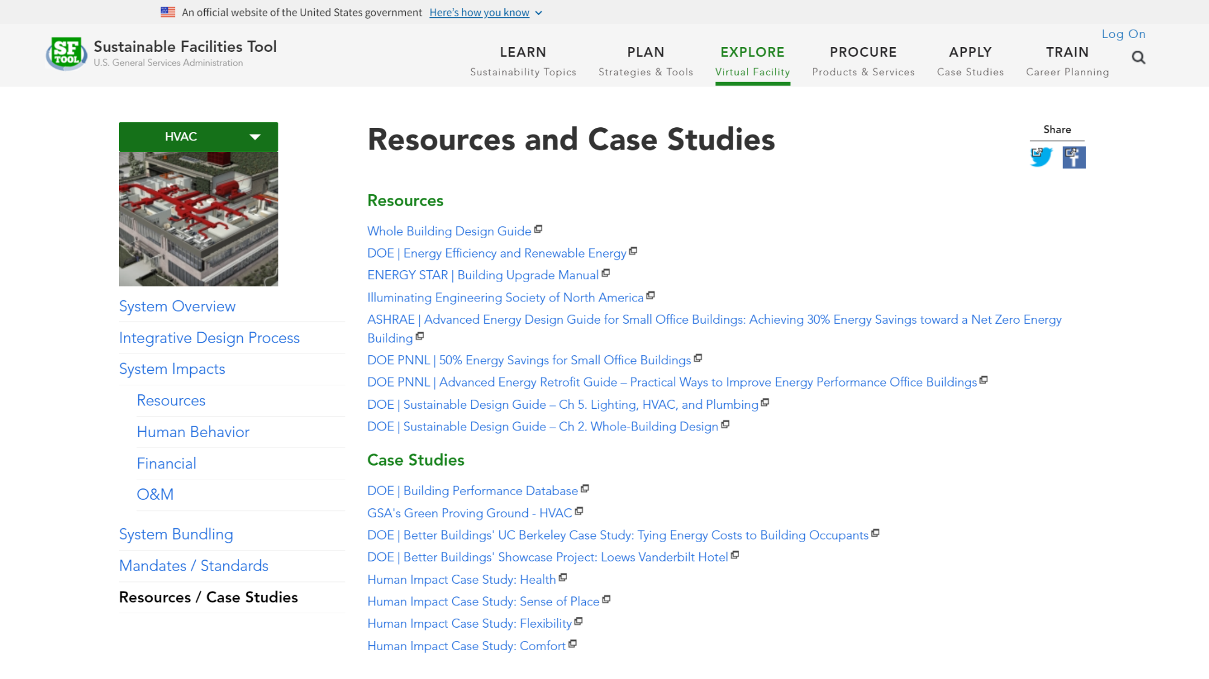
Notes:
Finally, each building system includes a section of further resources and case studies.

Slide 44
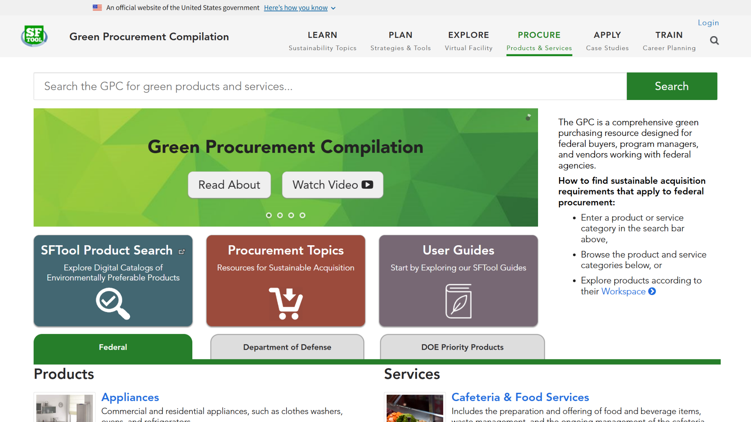
Notes:
The Procure section is the home of the Green Procurement Compilation, or GPC. Use GPC to find out what sustainability criteria to seek across hundreds of products and services.

Slide 45
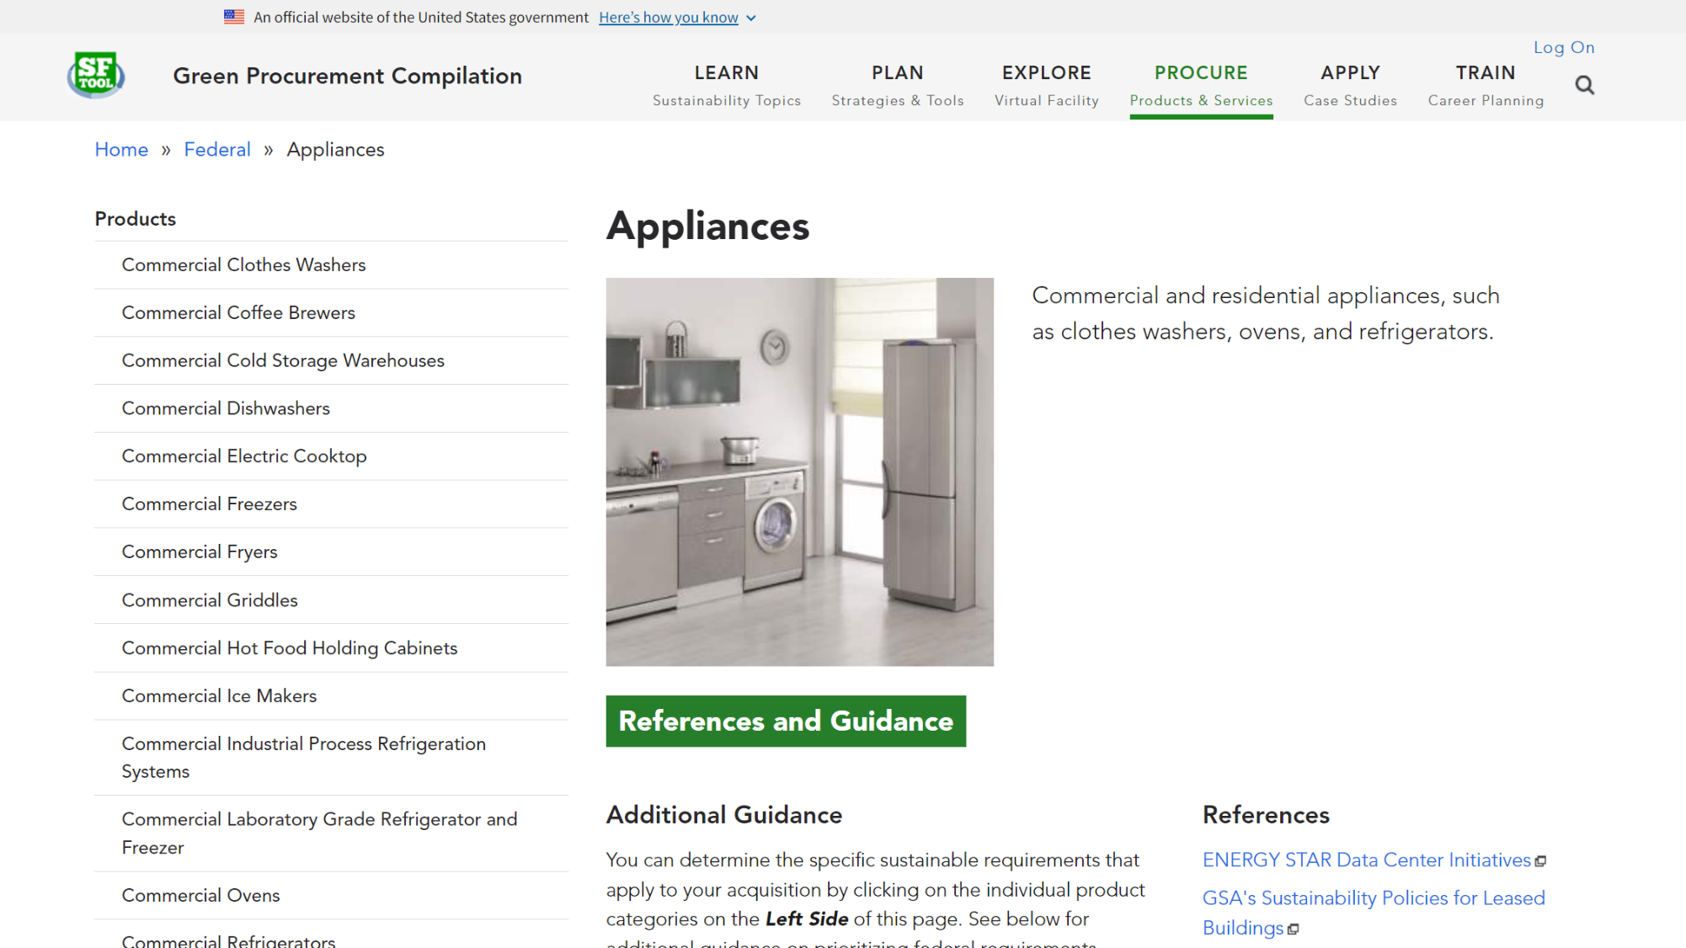
Notes:
When you select a product category, you’re taken to a list of products that fall under the category, as well as guidance that highlights the prioritization of purchasing programs based on the latest updates to FAR Part 23.

Slide 46
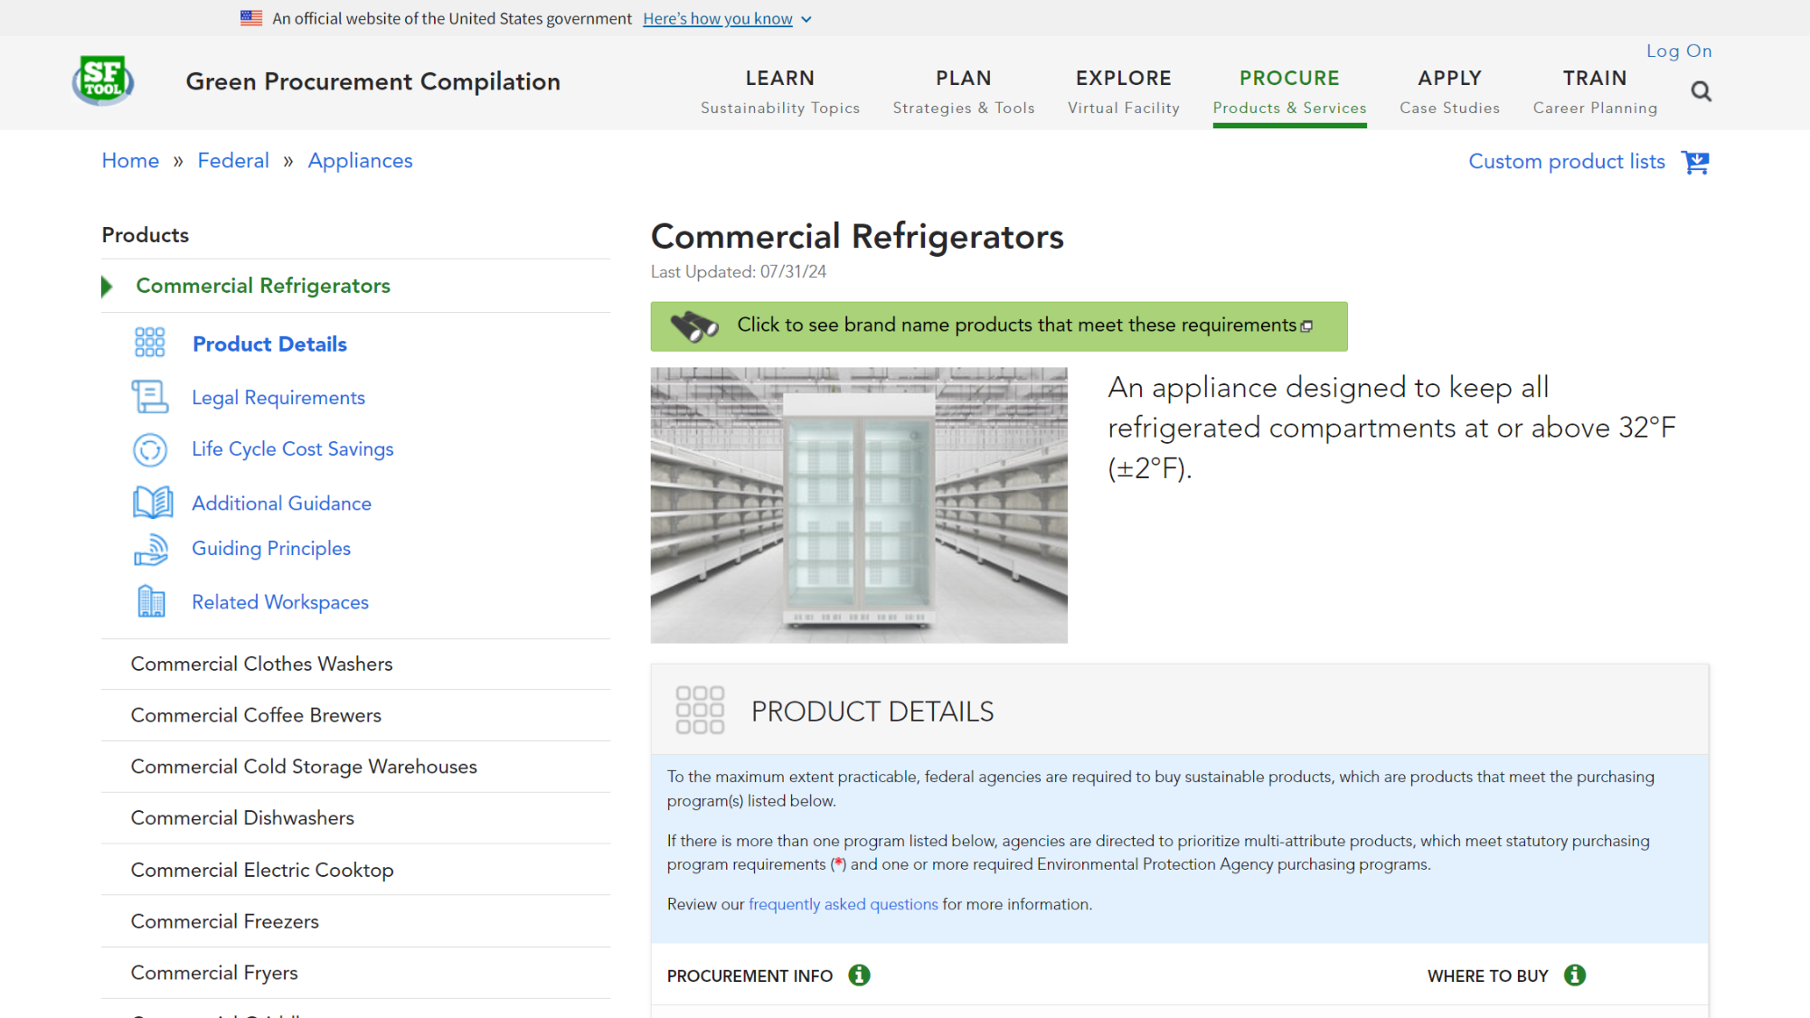
Notes:
Each product includes detailed procurement information, such as where to buy, appropriate FAR clauses, and life cycle cost savings.

Slide 47
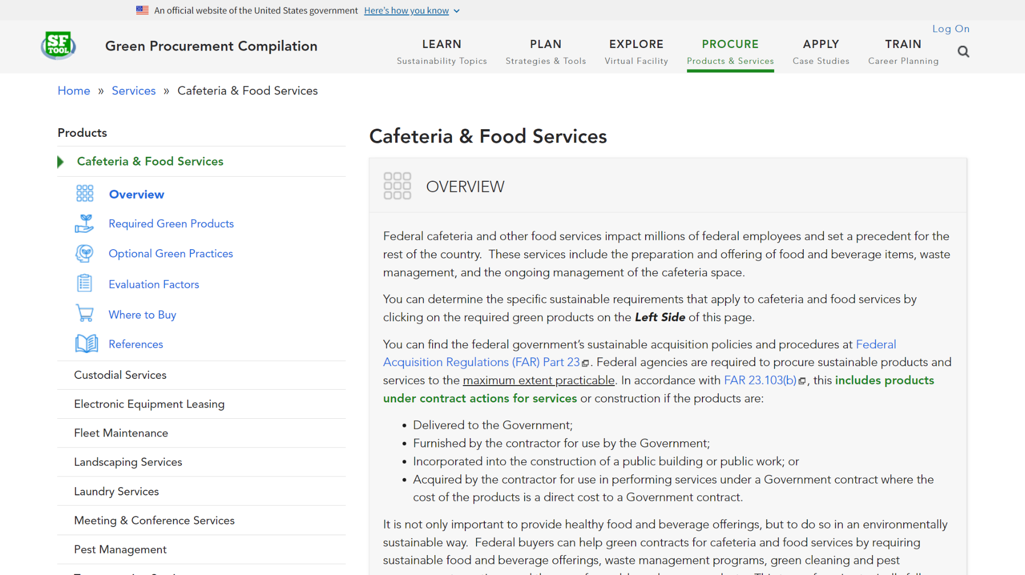
Notes:
Each service includes example past solicitations, required green products, optional green practices, sample evaluation factors, information on where to buy, and references.

Slide 48
Notes:
From the Procure section, you can navigate to SFTool Product Search, which simplifies environmentally responsible purchasing.

Slide 49
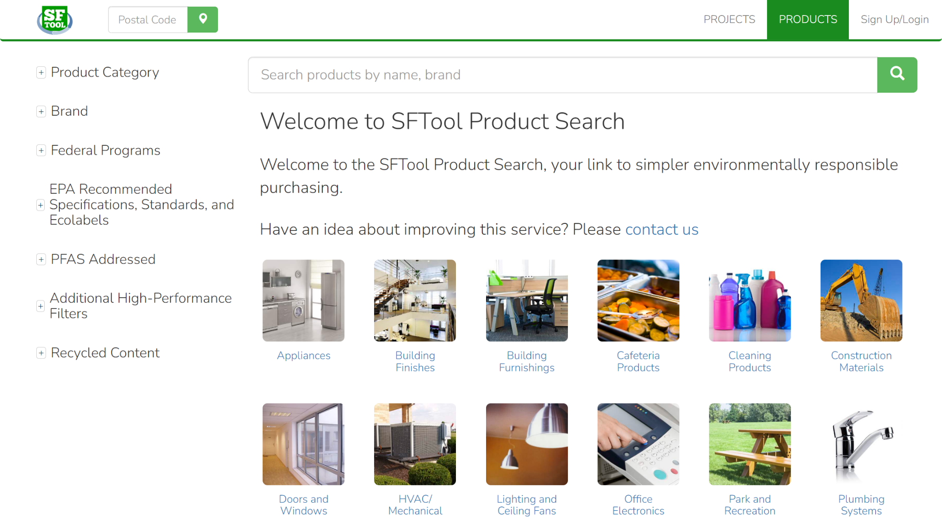
Notes:
With SFTool Product Search you can search over 150 categories and subcategories that represent over 5,700 brands and more than 300,000 products.

Slide 50
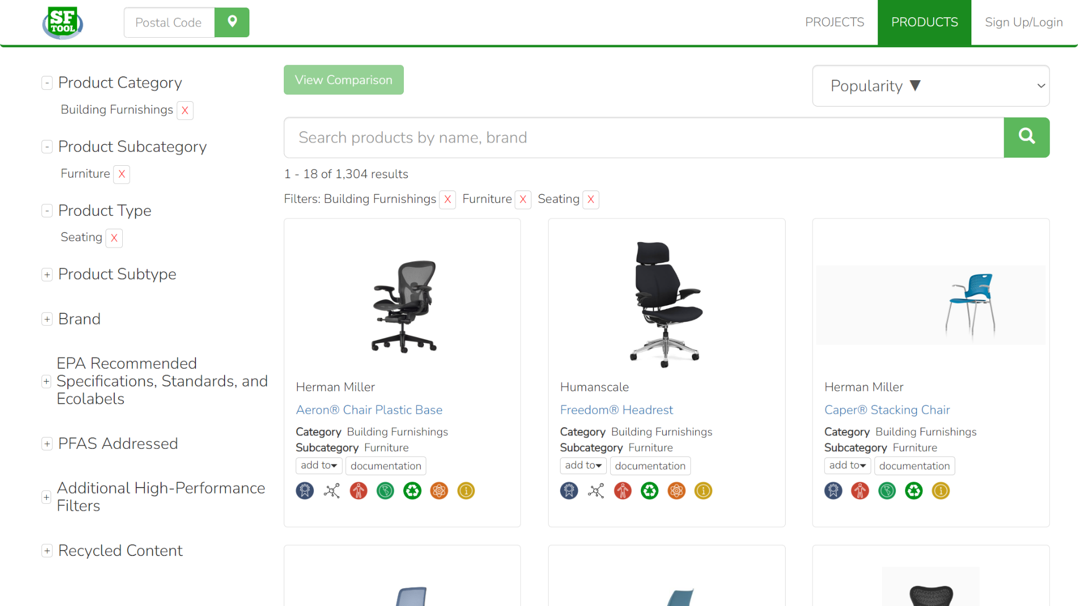
Notes:
Users can explore products by category, type, and brand as well as by certifications and performance specifications.

Slide 51
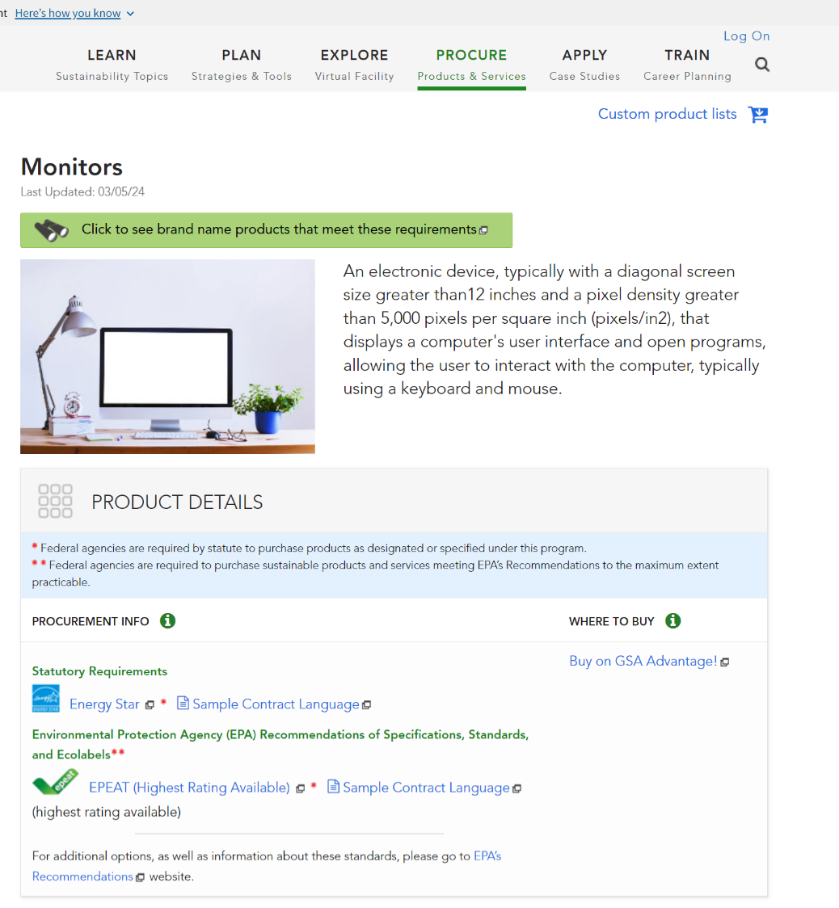
Notes:
All listed products align with the relevant Federal Environmental Program as covered by the Green Procurement Compilation (GPC) on SFTool.gov.

Slide 52
Notes:
Users can also compare products across a variety of subjects.

Slide 53
Notes:
From the Procure section, you can also navigate to Procurement Topics…

Slide 54
Notes:
Explore resources to support your procurements, including strategies and tools.

Slide 55
Notes:
Returning to the main portion of SFTool, you can use the Apply section to explore agency resources from the Interagency Sustainability Working Group, read case studies, and sign up for Federal newsletters.

Slide 56
Notes:
Under SFTool’s Train section, you will find the Facilities Management Institute. This is your primary source for complying with the Federal Buildings Personnel Training Act (or FBPTA). The box in the lower left will take you to AccelerateFM. AccelerateFM is not part of SFTool, but it’s the federal government’s main tool for managing the professional development of federal buildings personnel. The bottom right box has training videos from federal agencies. And the box in the upper right will take you to FEDSAT, which stands for the Federal Facilities Skills Assessment Tool, and which is part of SFTool….

Slide 57
Notes:
You can use this tool to assess your knowledge of building management. The assessment can help you identify areas where you might need additional training and locate free resources to fill the gaps. It takes about 4 hours to complete, but it can be much less if your existing credentials give you partial credit.
You can watch a short video introduction to FBPTA and FEDSAT by clicking the yellow circle…

Slide 58
Notes:
Click to play video in a browser window.

Slide 59
Notes:
The second tab on the FEDSAT homepage will provide you with a link to Accelerate FM. While the third tab will link you to resources to earn free continuing education credits….

Slide 60
Notes:
The free credits have been approved for a variety of certifications and may also qualify as “self-study” credits for other credentials. The listing includes 1 hour of credit for taking FEDSAT, as well as credits offered by other federal sources, such as the Whole Building Design Guide and Federal Energy Management Program.

Slide 61
Notes:
Back on the FEDSAT homepage, the fourth tab links to a list of resources that can help you learn more about all the topics covered in FEDSAT.
If you’re interested in taking the FEDSAT assessment, simply go to the first tab and log in or register. It’s open to the public, but there are some additional options for government users.

Slide 62
Notes:
Government users are encouraged to sign in with Google if their agency supports it. Otherwise, you can create a local SFTool account.

Slide 63
Notes:
Once logged in, click ‘START FEDSAT’…

Slide 64
Notes:
This will take you to the FEDSAT dashboard, where you can track your progress. If you have any questions about taking the assessment, check out the User Guide.
If you are a government user with an Accelerate FM account, get started by clicking the “Earn Credit” button to pass out of portions of FEDSAT based on your credentials.

Slide 65
Notes:
The earn credit button will take you to a form to link your account with Accelerate FM. Just enter the email address you used on Accelerate FM, confirm it, and click to link the account. Then go back to the dashboard.

Slide 66
Notes:
On the dashboard, you’ll see how much of the assessment your credentials have fulfilled. Get started on the rest by clicking the “Take Assessment” button.

Slide 67
Notes:
You will now see the assessment listing screen. The credits you earned by linking with Accelerate FM will appear as the smaller circle on each card, while your overall progress on the section appears in the main circle. From this screen, you can also explore learning resources by section. To continue the assessment, click the “continue” or “start” button at the bottom right of each card.

Slide 68
Notes:
The assessment consists of a series of multiple choice questions. If you don’t know the answer, you can click the help button in the upper right of each question to read more about the topic.

Slide 69
Notes:
Once you finish a section, you’ll see your score. You need to answer 70% correct to pass, but you can retry the questions you missed as many times as you need. On this screen, you’ll also see the learning resources related to the questions you missed.

Slide 70
Notes:
When you’ve completed the assessment, return to the dashboard to claim your certificate. If you linked your account to Accelerate FM, it will automatically update to reflect your completion.

Slide 71
Notes:
Finally, if you’re building your own app, your developers can use the SFTool API to access content directly. Just look for the “Developer” link in the footer of every page.

Slide 72
Notes:
Check out the footer to sign up for the SFTool Newsletter and follow SFTool on Social Media!
LinkedIn: https://www.linkedin.com/company/sftool/
X: https://x.com/sftool
Facebook: https://www.facebook.com/SFTool/
Pinterest: https://www.pinterest.com/sftool/

Slide 73
Contact
https://sftool.gov
sftool@gsa.gov
Social Security Support Center

